Slide 1
L5 - Legal reasoning: Problem questions and essays
LL1005 English Legal System, 2024-25
Dr Marton Ribary

Slide 2
Structure of the lecture
Building blocks of legal reasoning
Answering problem questions
Approaching an essay question
Vevox activity: Approaching an essay question

Slide 3
1. Building blocks of legal reasoning

Slide 4
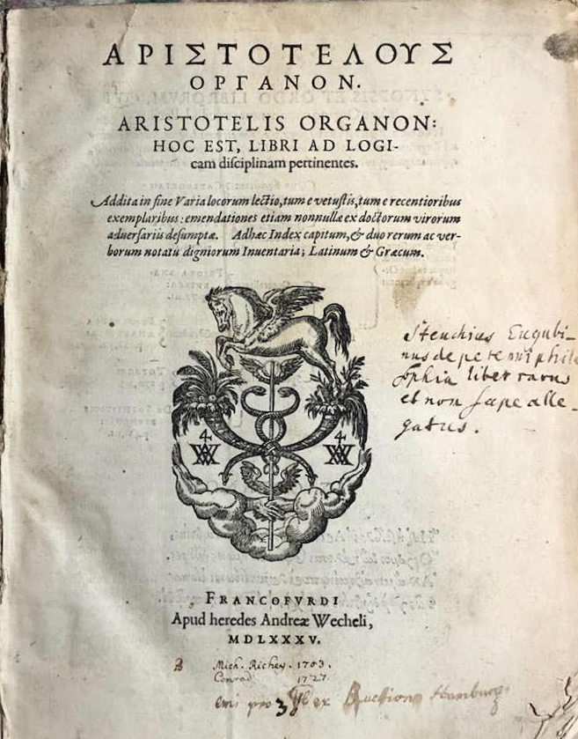
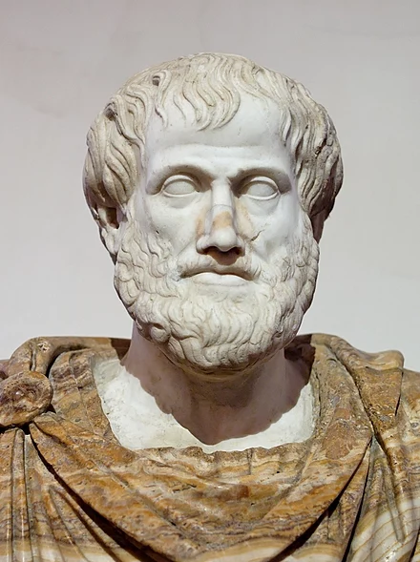
Aristotle - A blueprint for (legal) reasoning
Aristotle (384-322 BCE), Organon
⇒ a “tool” of practical and scientific reasoning in six books
Categories
On interpretation
Prior analytics
Posterior analytics
Topics
On sophistical refutations
The title page of Aristotle’s Organon
Roman copy (in marble) of a Greek bronze bust of Aristotle by Lysippos (c. 330 BC), with modern alabaster mantle

Slide 5
Aristotle - A blueprint for (legal) reasoning
Book(s) in the Organon | Topic discussed | Example
Categories | formulating a proposition (true/false) proposition = subject + predicate | “The swan is white”
On interpretation | the structure of language, logical meaning and modalities (tenses) | “All swans are white” can be negated as “There is one swan which is not white.”
Prior analytics | drawing valid inferences from propositions | “Socrates is human. Everything human is an animal. Therefore, Socrates is an animal.”
Posterior analytics | reasoning under certainty | e.g. definition > “Murder is the unlawful killing of a person with intent.”
Topics and Sophistical refutations | reasoning under uncertainty | constructing arguments based on premises which are incomplete or uncertain, constructing counterarguments challenging them

Slide 6
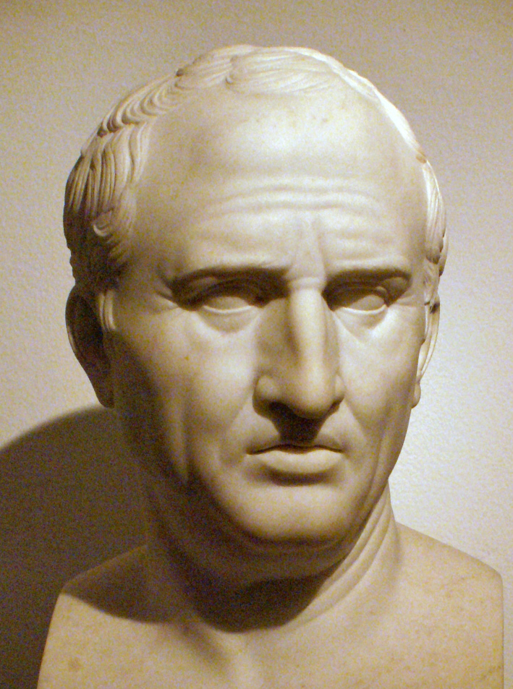
Ars iuris civilis - a science of civil law?
M.T. Cicero (106-43 BCE),
Topica
a manual for legal advocacy in Aristotle’s spirit to provide law with a rigorous structure and a scientific method

Slide 7
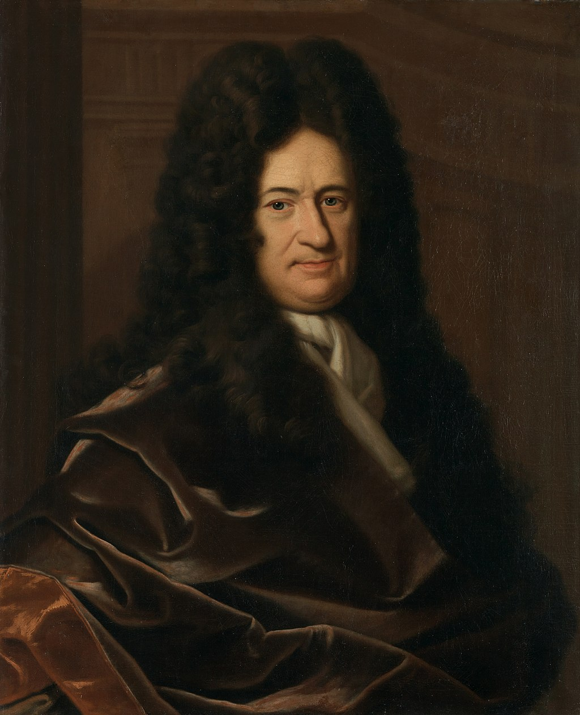
Ars iuris civilis - a science of civil law?
M.T. Cicero (106-43 BCE),
Topica
a manual for legal advocacy in Aristotle’s spirit to provide law with a rigorous structure and a scientific method
G.W. Leibniz (1646-1716), Elementa Juris Naturalis
universal logico-combinatorial methods applied to law (1) to work out a definition of justice and (2) lay the foundations of a self-directed legal system

Slide 8
Ars iuris civilis - a science of civil law?
M.T. Cicero (106-43 BCE),
Topica
a manual for legal advocacy in Aristotle’s spirit to provide law with a rigorous structure and a scientific method
G.W. Leibniz (1646-1716), Elementa Juris Naturalis
universal logico-combinatorial methods applied to law (1) to work out a definition of justice and (2) lay the foundations of a self-directed legal system
⇒ both attempts were vehemently rejected by practicing lawyers, both contemporary and in later generations

Slide 9
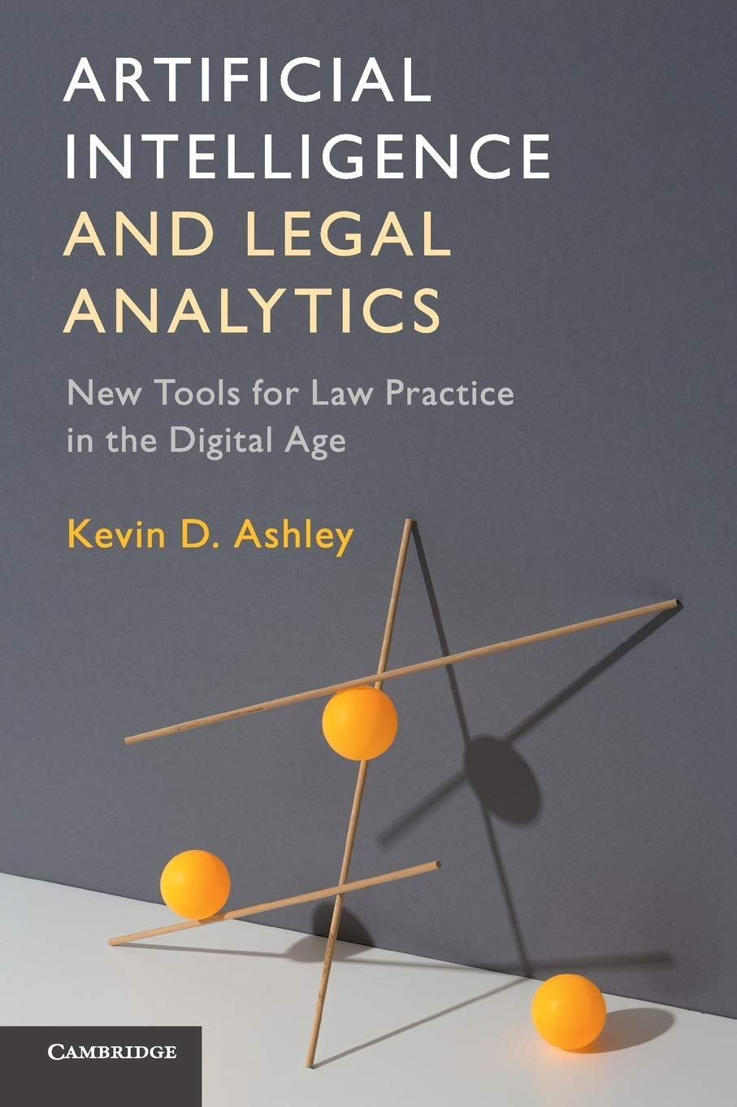
AI and law - Legal expert knowledge systems
Modelling legislation
XML markup to capture the structure (and meaning) of legal texts, e.g. legislation.gov.uk
legal ontologies / semantic web of legal concepts with an inference engine, e.g. LRI-Core
reducing legal texts to executable computer programs, e.g. British Nationality Act
Legal case-based reasoning (LCBR)
XML markup - The National Archives’ FindCaseLaw service
identifying legal factors and dimensions in case law
constructing defeasible (“valid until further notice”) arguments with computable argument schemes
⇒ “[expert systems] may be able to answer legal questions in a superficial sense, but they cannot explain their answers or make legal arguments” (Ashley 2017:3)

Slide 10
Working with legislation
identify the section that supports your argument:
note the key concepts and reflect on how they constitute a network
analyse the logical structure of the section and how it fits in the context
reflect on the four rules of statutory interpretation when applied

Slide 11
Working with legislation
identify the section that supports your argument:
note the key concepts and reflect on how they constitute a network
analyse the logical structure of the section and how it fits in the context
reflect on the four rules of statutory interpretation when applied
For example (S5 - Spencer 1995)
Section 8 (1) of the Contempt of Court Act 1981:
“contempt of court”, “in the course of their deliberations” etc.
if X gathers information from the jury “in the course of their deliberations” ⇒ X commits “contempt of court”
have we used a literal interpretation? are we meeting the law’s intention? is it true that “the court cannot be in contempt of itself” (R v Young [1995] 2 WLR 430, 434E)?

Slide 12
Working with case law
be aware of the threefold structure:
facts: specific and urgent (case)
factors and dimensions: intermediate concepts abstracting away from facts (bridge)
rules: abstract and general as expressed in legislation or in common law principles (law)

Slide 13
Working with case law
For example (S5 - Spencer 1995)
solicitor is informed that drunken jurors used a ouija board in their hotel room to make contact with a murdered couple
jury-not-in-courtroom, irregularity-of-jury-deliberation etc.
jury-not-in-courtroom is NOT “in the course of their deliberations”
be aware of the threefold structure:
facts: specific and urgent (case)
factors and dimensions: intermediate concepts abstracting away from facts (bridge)
rules: abstract and general as expressed in legislation or in common law principles (law)

Slide 14
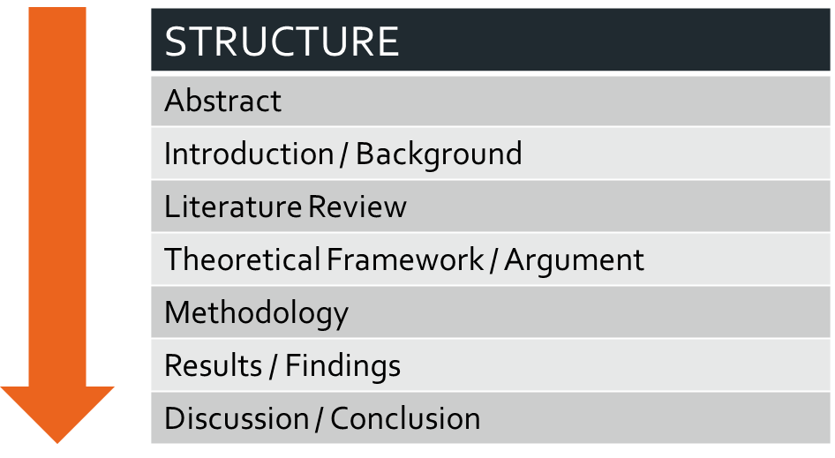
Working with secondary sources
An example: E Maes, ‘Legal implications of smoking (bans) in English prisons’ (2019) 39 Legal Studies 321, doi:10.1017/lst.2018.46

Slide 15
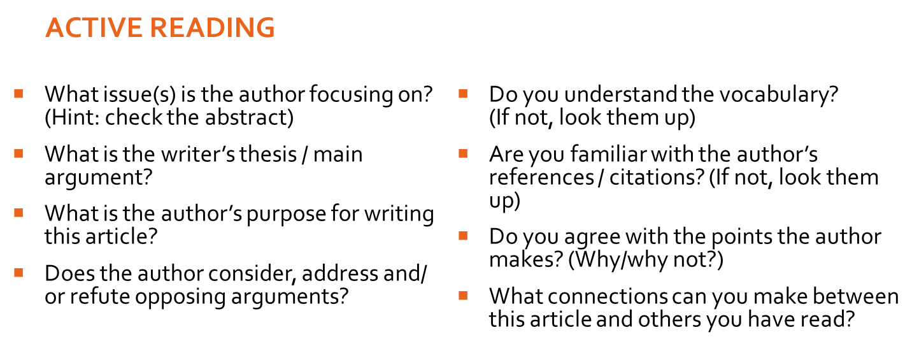
Working with secondary sources

Slide 16
Working with secondary sources
identify the argument that supports yours:
be aware of the main argument of the piece which gives context (this may be implicit)
be aware of the modality of the argument that you want to use (e.g. sarcasm, caution)
analyse the argument for soundness and clarity
what support does the author provide?

Slide 17
Working with secondary sources
identify the argument that supports yours:
be aware of the main argument of the piece which gives context (this may be implicit)
be aware of the modality of the argument that you want to use (e.g. sarcasm, caution)
analyse the argument for soundness and clarity
what support does the author provide?
For example (S5 - Spencer 1995)
“the supposed need for social science research into how well juries do their job is surely of secondary importance” (p. 521):
the Contempt of Court Act 1981 should address “the jurors’ irresponsible behaviour”
sarcastic typology of jurors
support is a thought experiment and some logical analysis

Slide 18
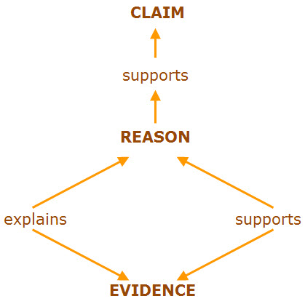
Supporting “evidence” for an argument
A strictly non-exhaustive list:
data - “I have the numbers to back this up”
but beware the danger of fallacies of statistical reasoning and probability
logic - “I analysed the hell out of it, and it makes sense”
demonstrate the analysis, reflect on key concepts and alternative interpretations
authority - “someone smart and respected said so”
not necessarily a person, it could be an organisation, a document etc.
reflect on what makes X an authority and whether it is justified
reflect on the authority’s scope, e.g. an authority in maths may not be so in law
anecdote - “this story demonstrates that I am right”
don’t underestimate the persuasive value of a story, it’s illuminating and powerful

Slide 19
2. Answering problem questions

Slide 20
Essay and PQ - A comparison
Essay | PQ
responds to an essay question | responds to a problem scenario
imagine an audience of law colleagues interested in a contentious area of law | imagine an audience of impatient judges and distressed clients
builds an argument about a point in law (not merely describes) | applies the law (legislation and case law) to a fact pattern
presents the context inasmuch as it is relevant to the question | only discusses the relevant issues and gives more weight to the contentious ones
no headings (but you could use them during the writing process) | could use headings to mark disputes and main issues
immaculate OSCOLA referencing | immaculate OSCOLA referencing

Slide 21
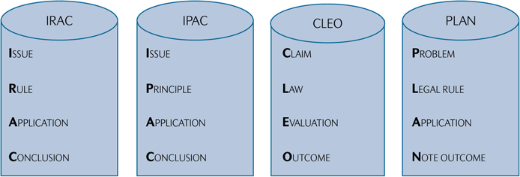
The traditional IRAC method and its cognates
E Finch and S Fafinski, Legal Skills (9th edn, OUP 2023), 359

Slide 22
A fictional IRAC (from S2)
“A father of three sons killed two of them in madness. Cured by the third, he disowns him.”
Issue: Is the father right to disown his son?
Rule (fictional!): Inheritance Act s.8: “One cannot disown a child who did nothing wrong.”
Application: In the father’s view, his son wrongfully cured him of madness in order to be the sole heir giving the father right to disown him.
Conclusion: If the father’s interpretation of the facts is correct, he lawfully disowned his son after the son had cured him of madness.
“Super-IRAC”: The father rightfully disowned his son as he thought he had been wrongfully cured by him to become the sole heir (Inheritance Act s.8).

Slide 23

The traditional IRAC method and its cognates
No matter what acronym you follow, all methods require you to:
Be able to identify what the question is asking
Understand what part of law is relevant to answer the question
Employ the law to the facts of the problem question
Conclude by showing what is likely and what is unlikely to happen

Slide 24

A five-stage guided approach to problem solving
(1) Reading case law
extracting doctrinal content from legal sources
(2) Mapping legal doctrine
organising doctrinal content into a coherent framework
(3) Approaching a PQ
applying the framework to problem scenarios
(4) Constructing legal advice
detailed, authoritative, and persuasive
(5) Finalising legal advice
writing up the advice in an economical and elegant manner
Marton Ribary and Antony Starza-Allen, ‘Computing legal analysis: A guided approach to problem solving in contract law’ (2023) 33 Legal Education Review 143 [link]

Slide 25
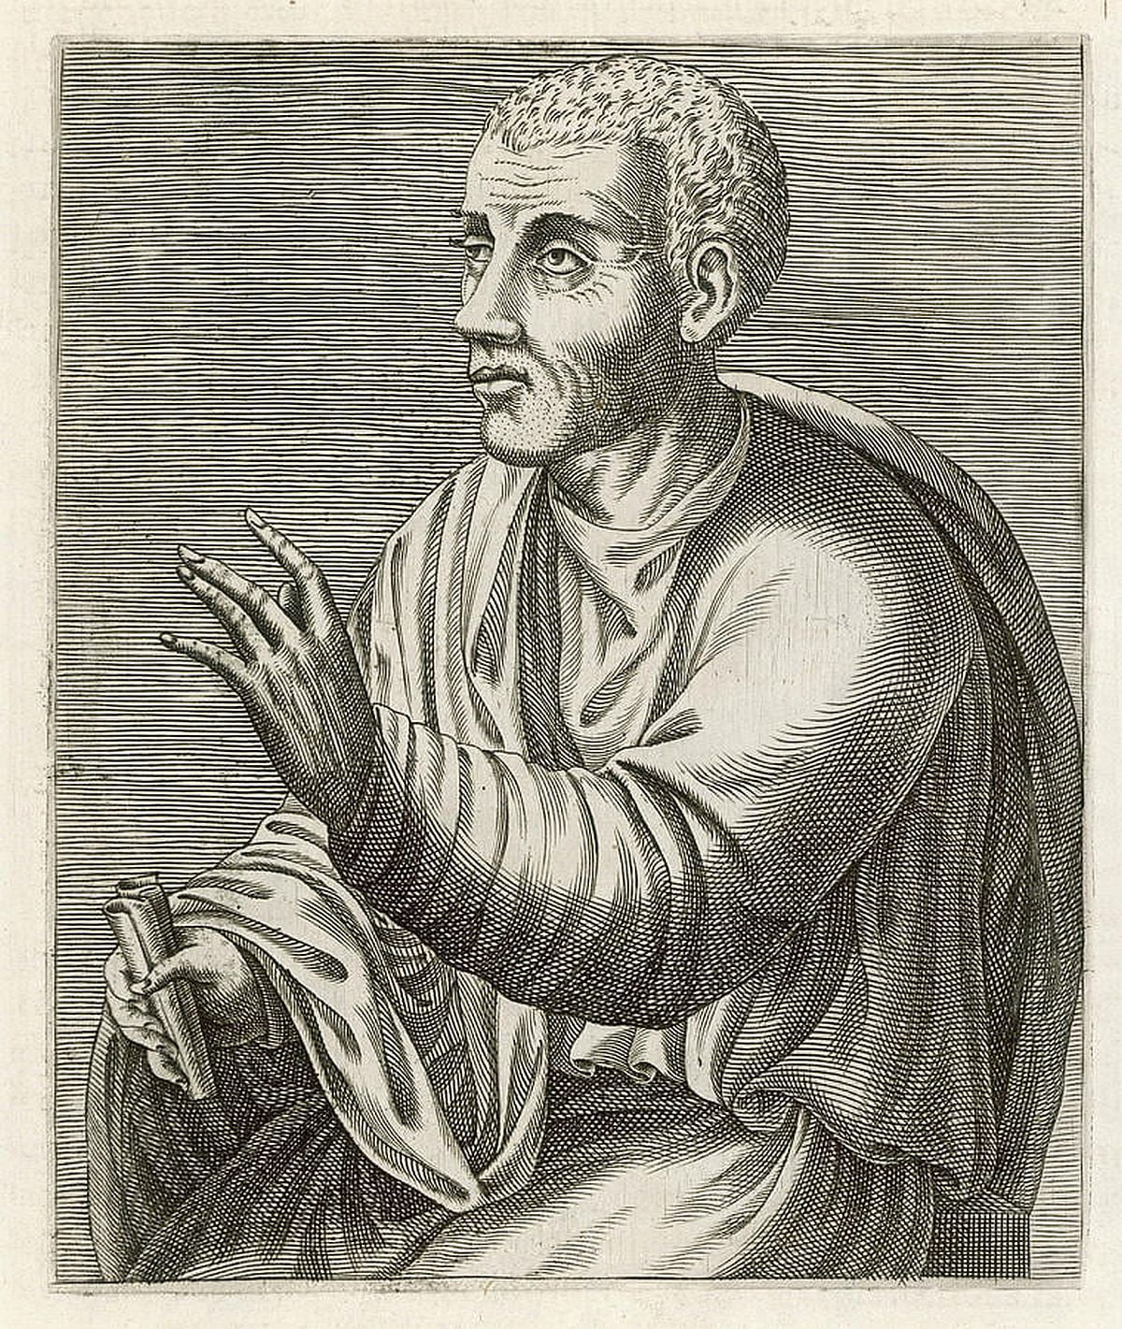
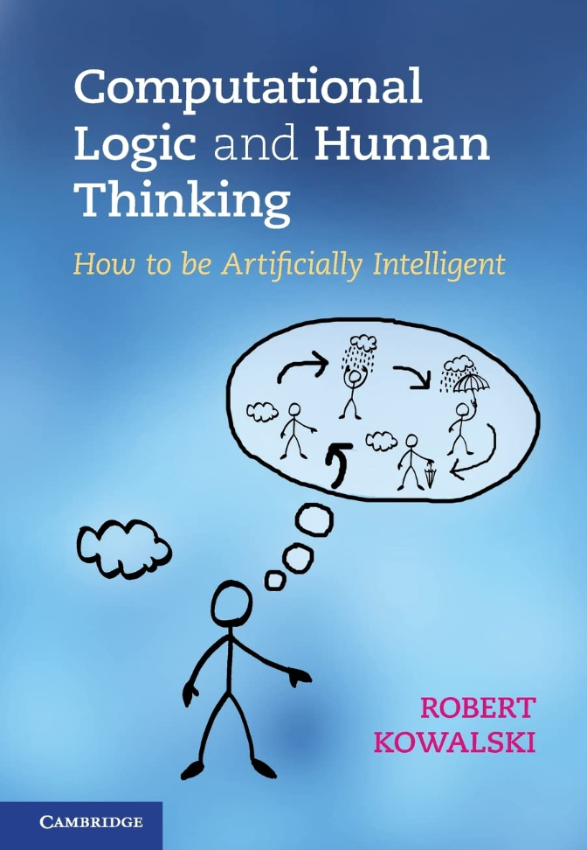
The starting point - practical thinking
Following the ancient ideal of legal education (see Quintilian in S2):
structured knowledge
rules of reasoning
rhetorical eloquence
Mirrored in Robert Kowalski’s ideal of “practical thinking”
computational logic applies the laws of logic and the principles of structured problem solving
⇒ key components of computer coding as well as the precursor to legal reasoning.

Slide 26
The starting point - practical thinking
Following the ancient ideal of legal education (see Quintilian in S2):
structured knowledge
rules of reasoning
rhetorical eloquence
Mirrored in Robert Kowalski’s ideal of “practical thinking”
computational logic applies the laws of logic and the principles of structured problem solving
⇒ key components of computer coding as well as the precursor to legal reasoning.

Slide 27

1. Reading case law
legal English
challenging in both vocabulary and syntax
extra layer of difficulty in deciphering the personal style of judges in case law
read cases in a smart way
focus on passages revolving around key phrases emphasised in lecture slides and the textbook
take structured notes
focus on concepts in the judgment mediating between facts and rules

Slide 28
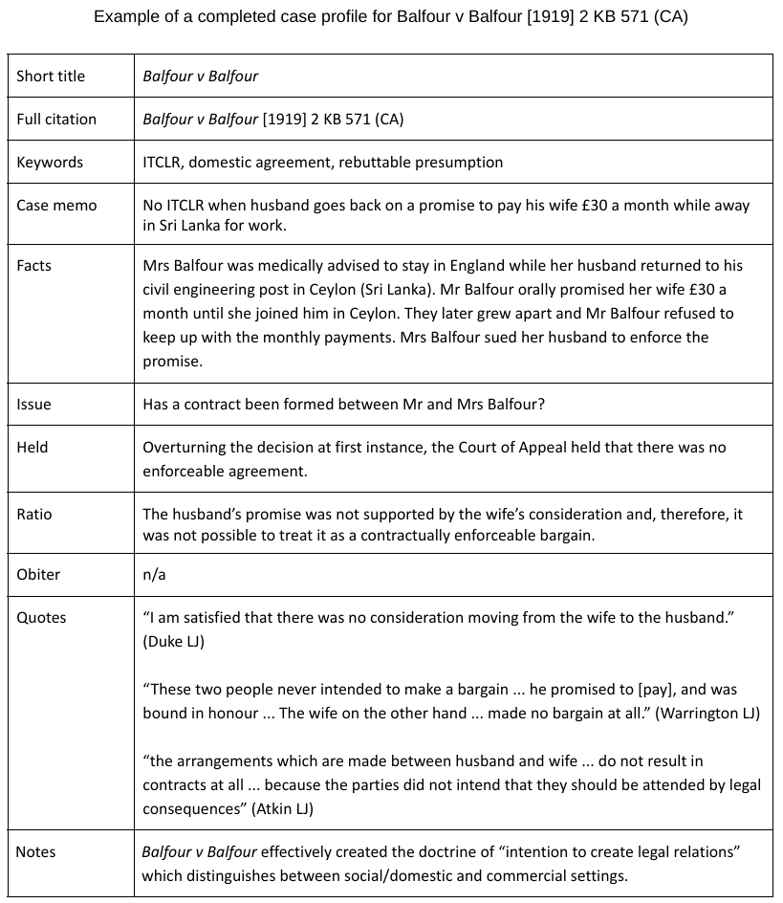
1. Reading case law
Case briefing (see S6 “Profiling a case” on R v Bentham)
short title
full citation
keywords
case memo
facts
issue
held
ratio
obiter (optional)
quotes (optional)
notes (optional)

Slide 29
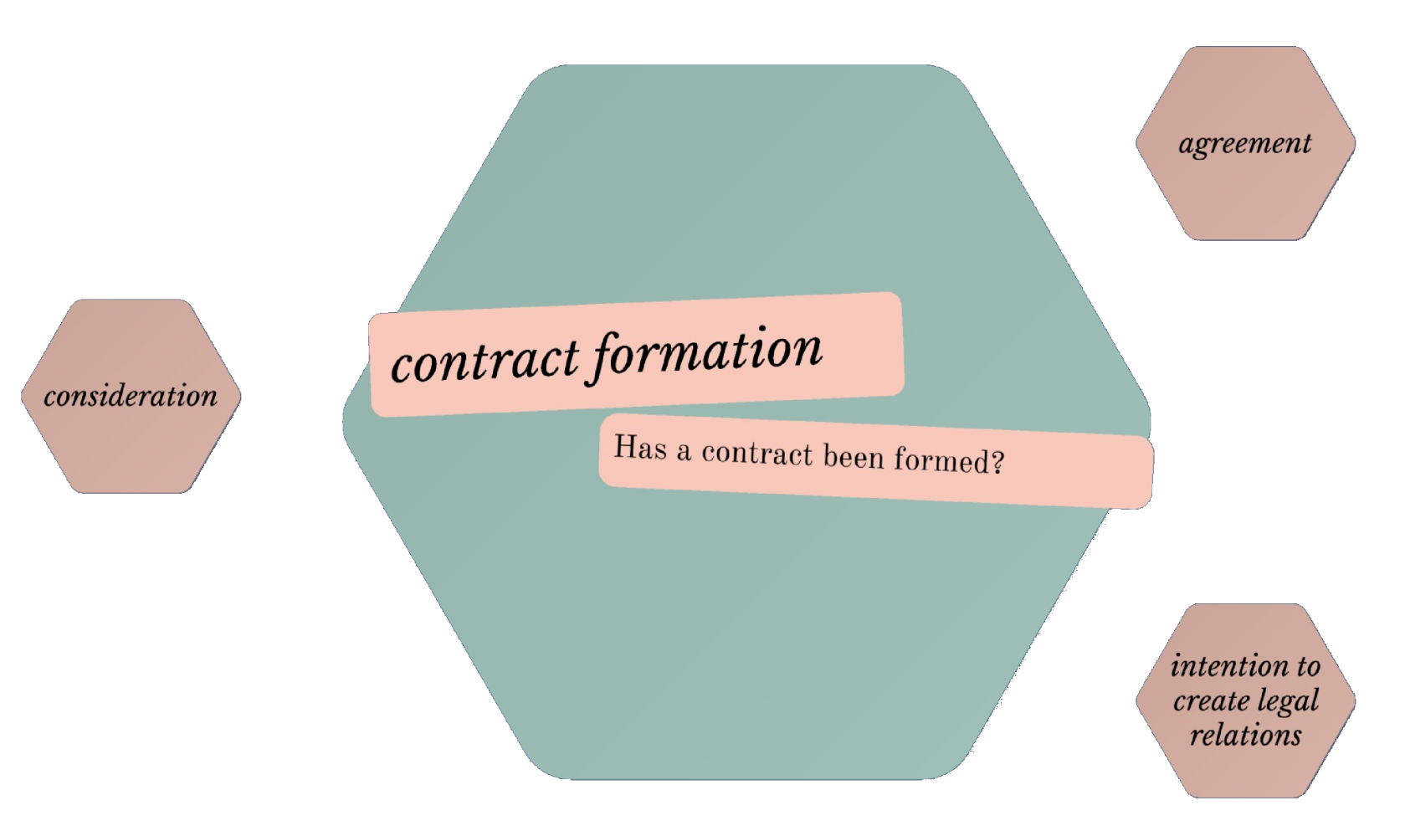
2. Mapping legal doctrine
Visual representation of the structure of legal content by arranging concepts and cases on
concept trees
dynamic mind maps
Such visual frameworks
capture the whole and impose a structure on a messy doctrine
admittedly simplified
anomalous rules do exist and one needs to treat these frameworks with a pinch of salt
Click the image for a draft mind map of the doctrine of contract formation in Prezi

Slide 30
3. Approaching a PQ - A spin on IRAC
Ingrid emails Jules offering to sell a consignment of woolly jumpers for £1,000. Jules posts her acceptance to Ingrid but her letter does not arrive for a week because it has been misaddressed.

Slide 31
3. Approaching a PQ - A spin on IRAC
Ingrid emails Jules offering to sell a consignment of woolly jumpers for £1,000. Jules posts her acceptance to Ingrid but her letter does not arrive for a week because it has been misaddressed.
Fact | Legal issue | Case law | Rule
to the fact |  |  | apply rule
highlighting pieces of text in the PQ (as brief as possible)
identifying the legal issue triggered by the text
matching it with the relevant case law(s)
spelling out the applicable rule
circling back from rules to fact with application

Slide 32
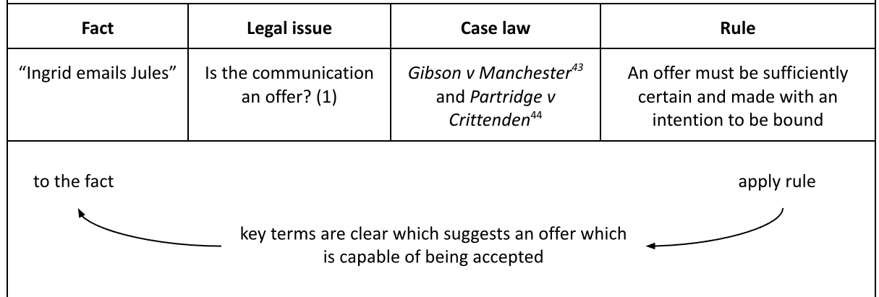
3. Approaching a PQ - A spin on IRAC
Ingrid emails Jules offering to sell a consignment of woolly jumpers for £1,000. Jules posts her acceptance to Ingrid but her letter does not arrive for a week because it has been misaddressed.

Slide 33
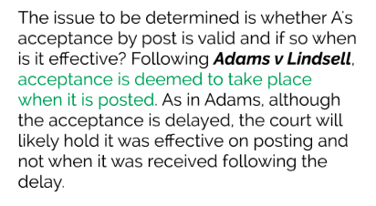
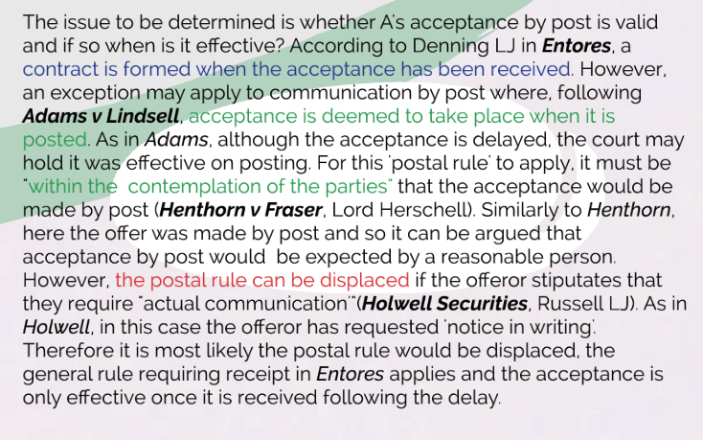
4. Constructing legal advice
An example of a “simple” IRAC-based advice
An example of an IRAC-based advice developed using categories in the legal argument diagram

Slide 34
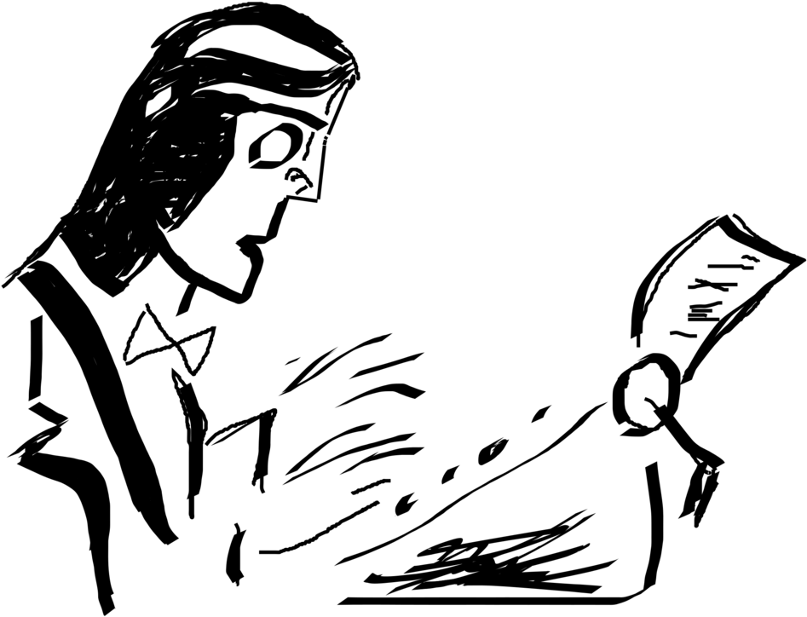
5. Finalising legal advice
adjusting written presentation to the audience
the impatient judge
the distressed (paying) client
assessing the relevance of issues
skim through the obvious issues
discuss the contentious ones in detail
edit for length, clarity and elegance
allow yourself some rhetorical flourish

Slide 35
3. Approaching an essay question

Slide 36

Question / Answer (“thesis sentence”)
Ask the question worth answering (if not set)
a simple, clear and provocative question invites a simple, clear and provocative answer
puts you on a track for critical analysis
Make sure you answer the question (“thesis sentence”)
you don’t simply take inspiration from the question to talk about a topic, you must answer the question
when marking an essay, the marker evaluates how well the essay answers the question (so if you don’t address it, your essay will get a poor mark even if it is otherwise a good essay)

Slide 37
Question / Answer (“thesis sentence”)
Ask the question worth answering (if not set)
a simple, clear and provocative question invites a simple, clear and provocative answer
puts you on a track for critical analysis
Make sure you answer the question (“thesis sentence”)
you don’t simply take inspiration from the question to talk about a topic, you must answer the question
when marking an essay, the marker evaluates how well the essay answers the question (so if you don’t address it, your essay will get a poor mark even if it is otherwise a good essay)

Slide 38

Structure
Introduction
question > answer > summary of main arguments
wrapped in context and rhetorical flourish that communicates your style
Body
elaborating the arguments with supporting evidence
one paragraph - one idea ⇒ you could use headings to keep to that one idea, headings that you will eventually remove
consider possible counterarguments and your response
Conclusion
revisit your answer and qualify it in light of your analysis if necessary
again, don’t be mechanistic, allow your style to shine through

Slide 39

Writing up in stages
From outline to paragraph
prepare an outline first, but allow yourself to explore unexpected areas as you write
leave a mark for reference, but don’t break the flow of writing - return to references in the editing stage
connect ideas within a paragraph, and also bridge paragraphs
Editing
put your writing aside, sleep on it, and revisit the next day
be your own most brutal critic - cut and rewrite
write up your references
Proofreading
don’t skip it, read out your piece, and change if it sounds awkward
check grammar, spelling, references and formatting
Tip: Plan your essay writing - 2-3 hours a day over several days for best result

Slide 40
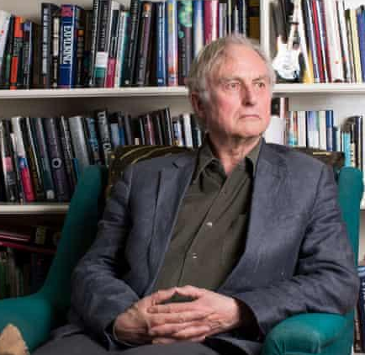
Essays - Why should you care?
Getting the mark that you need
a key assessment type at university
Critical thinking and problem solving
the most sought after transferable skill (no wonder why American philosophy graduates are in high demand)
Putting your opinion across
opinion is not the antonym of fact - opinion is based on facts and evidence with the intention to influence others
flushing out a disagreement is good, but the opposing sides are not necessarily equal
Build a solid argument / Spot the flaws of your opponent’s
crucial for advocacy
channeling a debate within the tracks of reason
“When two opposite points of view are expressed with equal intensity, the truth does not necessarily lie exactly halfway between them. It is possible for one side to be simply wrong.”
Richard Dawkins, The God Delusion (Random House 2009)

Slide 41

Essays - How should you care?
Allow yourself time
don’t skip the thinking in the beginning - that’s the most fun part
do research and read around the subject over a long period of time
proceed in stages, 2-3 hours a day, allow time to digest and refresh
Face up to issues in your work
talk to your tutors, peers, friends and family
be open to criticism - if someone criticises your work, that’s about your work, not your person
Practise and take the opportunity to improve
we are not born with the skills of reasoning, we learn it
read good texts, fiction, non-fiction, academic pieces, judgments etc.

Slide 42
4. Vevox activity: Approaching an essay question

Slide 43


Step #1: Answering the question
Is the jury out of control? Answer the question with reference to R v Young [1995] 2 WLR 430 and reflect on the way the court used statute, case law and principles of common law to decide this case.
105-524-548

Slide 44
Step #2: Answer = The thesis sentence
Is the jury out of control? Answer the question with reference to R v Young [1995] 2 WLR 430 and reflect on the way the court used statute, case law and principles of common law to decide this case.
Shortlist of answers - Voted first is highlighted and carried over to the next step

Slide 45
Step #3: Constructing an argument
[voted thesis sentence]
Construct one argument in support of the thesis sentence. Accompany it with at least one piece of “supporting evidence” (see slide 19). For the purposes of this exercise, this piece of “supporting evidence” could be fictional.

Slide 46
Step #3: Constructing an argument - Examples
Four examples from the Vevox exercise:

Slide 47
What’s next…
S6: Profiling a case
L6: Legal research and referencing
Find and read R v Bentham [2005] UKHL 18.
This session will introduce you to the essential research and referencing skills you will need to study law. You will learn how to search for authoritative legal resources through key legal databases Westlaw, Lexis+UK, Oxford Law Trove, and others. You’ll also build your knowledge on avoiding plagiarism and the OSCOLA referencing style, an integral part of writing assignments.

Slide 48
Q&A
Raise your hands or ask on Vevox

