Slide 1
Legislation and Statutory Interpretation
Dr Millicent Ele
LL 1005 – English Legal System, L2, 2024/25

Slide 2

Welcome to RHUL, Department of Law and Criminology!
I am Dr Millicent Ele
Lecturer in Law
Co-convener of the ELS
Office: Arts Building - ABF3A
Email: millicent.ele@rhul.ac.uk
Consultation & Feedback Hours:
Tuesdays and Thursdays – 1-2pm
Pls email me for appointment.

Slide 3

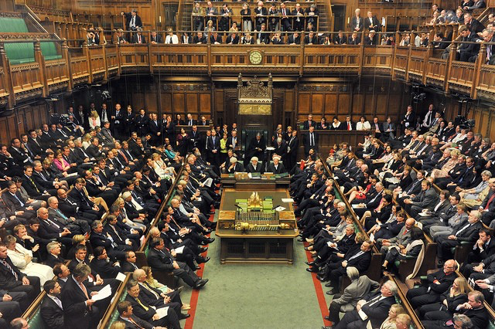
The Parliament
Parliament Acts
1911 and 1949
Constitutional Reform
Act 2005

Slide 4

Vevox #1: How many MPs sit in the House of Commons?
Join at: vevox.com
Or vevox.app
ID: 116-330-323
How many MPs sit in the House of Commons?

Slide 5
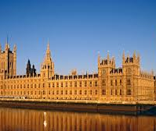
The Palace of Westminster
Two Chamber Assembly – House of Commons and House of Lords
Elected representatives sit in the House of Commons (includes Prime Minister and senior members of the cabinet and occasionally the King).
A Bill may be introduced in either House.

Slide 6
Vevox #2: Statutes and Prerogative Powers
Join at: vevox.com
Or vevox.app
ID: 116-330-323
Following a series of terrorist explosions in central London, the government invoked emergency prerogative powers. These powers enabled the government to take control over commercial buildings damaged in the explosions. The powers also enabled the government to deny the occupiers access to those buildings while forensic teams undertook the lengthy process of gathering evidence. Recognising the impact 0n the occupiers of such buildings, the Parliament passed legislation creating a compensation scheme allowing those affected to claim for any costs and losses incurred while those buildings are under the government’s control. Notwithstanding this new legislation, the government is continuing to use the prerogative powers in order to avoid paying any such compensation under the statutory scheme.

Slide 7
Legislation
Legislation is the main source of law in the United Kingdom.
Legislation/Statute/Acts of Parliament - the laws passed by the Parliament. (Other sources of Law include Case law/common law - laws derived from cases decided by judges, international law, EU & Human Rights law, etc.)
The United Kingdom is a constitutional monarchy, and parliamentary democracy and the formal head of state is the King.
All legislations, therefore, need approval by the King - Royal Assent; and the Royal coat of arms appears on every piece of legislation.
There is Separation of Powers between the Executive that implement the law, the Legislature that makes the law, and the Judiciary that interprets the law.

Slide 8
Making New Laws - What is a Bill?
A bill is a draft law; a proposal for a new law to be discussed by Parliament.
It becomes an Act if it is approved by a majority in the House of Commons and House of Lords, and (formally) agreed to by the reigning monarch – The Royal Assent.
It must be introduced in one of the Houses of Parliament (the House of Commons or the House of Lords
Once a bill is passed and becomes a statute, it remains in force until it is repealed by the Parliament. In R v Duncan (1944), the defendant was convicted of fortune-telling under the Witchcraft Act (1735) despite the fact that the Act is over 200years old. It was still good law.
To see the current bills before the Parliament, visit the House of Parliament website at: https://bills.parliament.uk/

Slide 9
Vevox #3: How to Repeal a Statute?
Join at: vevox.com
Or vevox.app
ID: 116-330-323
The UK government has introduced a Parliamentary Bill (“the Bill”) to repeal a UK statute. The government is able to command a majority in the House of Commons, but the Bill is opposed in the House of Lords. The Parliament Act 1911 and 1949 are invoked in order to pass the Bill into law.

Slide 10
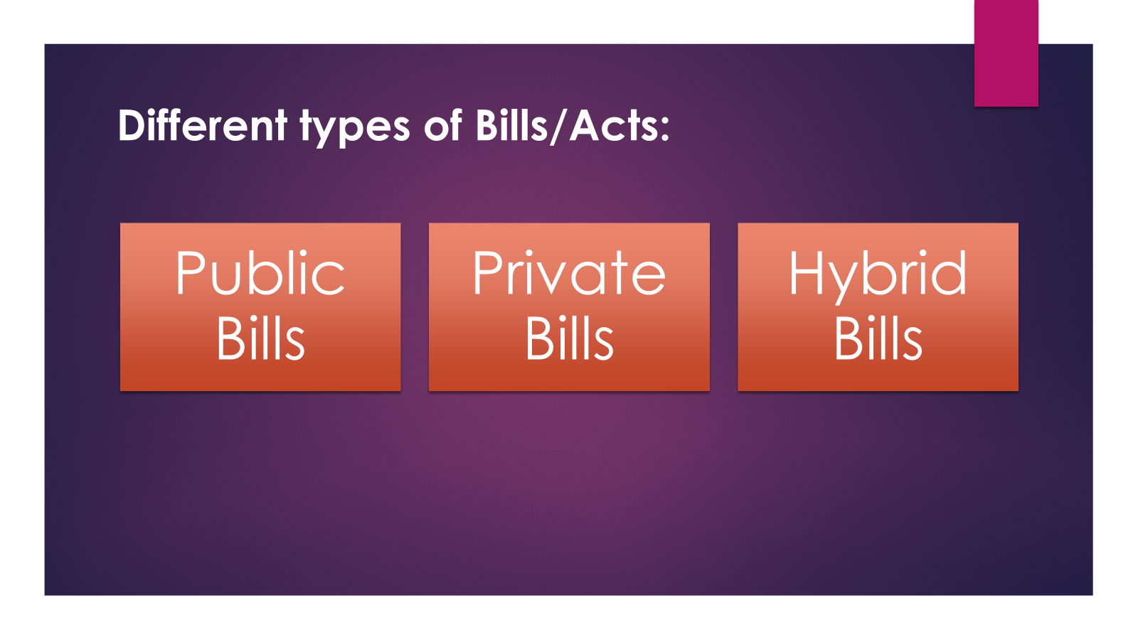
Types of Bills

Slide 11
Who introduces Bills?
Ballot Rule
Ten Minute Rule
Presentation
Government Bills
Private Members Bill

Slide 12

The Legislative Process

Slide 13
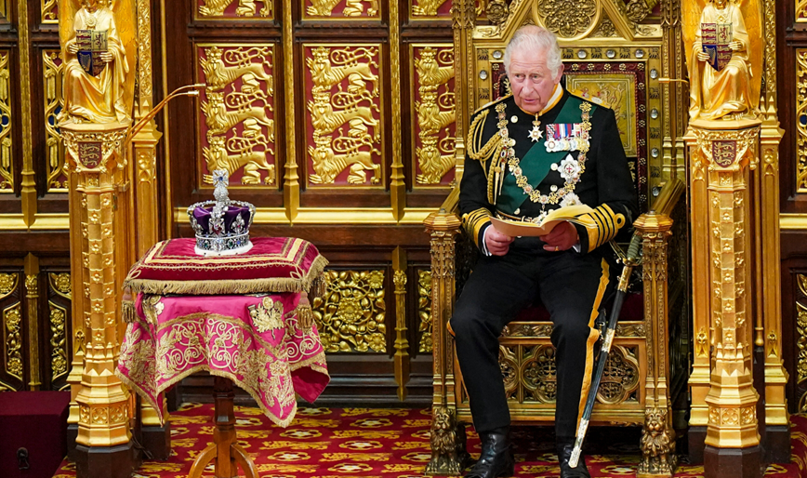
The King’s Speech (State Opening of Parliament)

Slide 14
The Legislative Process
A Bill can be introduced in either House
First Reading: Purely a formality. No debate. The title of the bill is read out and the MPs are informed where to find the bill.
Second Reading: Debate on general principles and policy. First Vote. The Bill may be defeated.
Committee Stage: Detailed consideration, clause by clause
Report Stage: Further amendments may be proposed. Then a report on the changes.
Third Reading: Unusual for any further amendments. Bill is accepted and is handed over to the other House to follow the same stages as above.
Consolidation of Amendments - Once the 2nd House is done, then the amendments in the HoC and HoL will be consolidated. The Bill could go back and forth between the two Houses at this stage – the so-called ping-pong stage until the two Houses are happy with the bill. Then it is sent for the Royal Assent.
Royal Assent – Formality. [See the Royal Assent Act of 1967]
Notes:
.

Slide 15
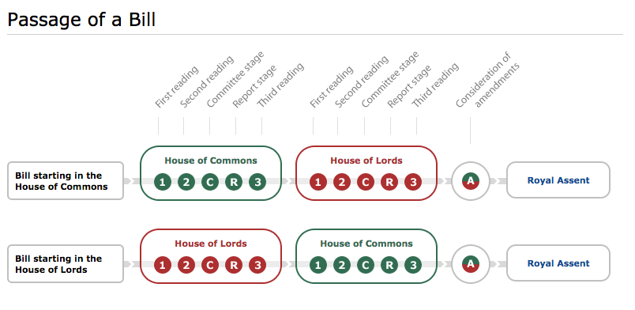

Slide 16
Vevox #4: Withholding Royal Assent
Join at: vevox.com
Or vevox.app
ID: 116-330-323
When was the last time Royal Assent was not granted to the legislation in England?

Slide 17

Parliamentary Scrutiny
Parliamentary Scrutiny is the close examination and inquiry into the policies, actions and spending carried out by the House of Commons and the House of Lords and their committees. It could be through:
Media coverage of parliamentary proceedings
Debates
Public Opinion
Prime Minister’s Question Time
Financial Scrutiny e.g. the budget
Parliamentary Committees

Slide 18

Jurisdictional/Geographical Extent & Devolution
Some Bills/Acts introduced by Parliament apply to the whole of the UK. e.g. Human Rights Act 1998.
However, some Bills/Acts apply differently to different parts of the UK. But majority form part of the laws of England and Wales. e.g., see s. 217 of the Equality Act, 2010.
The role of devolution: Law-making powers in some areas rest with the Scottish Parliament, the Welsh Assembly and the Northern Ireland Assembly, rather than the UK Parliament. This is what is known as devolution of powers in the UK

Slide 19



Devolution – Coat of Arms

Slide 20
Vevox #5: First Ministers
Join at: vevox.com
Or vevox.app
ID: 116-330-323
Who is the Scottish First Minister?

Slide 21
Vevox #6: First Ministers
Join at: vevox.com
Or vevox.app
ID: 116-330-323
Who is the Welsh First Minister?

Slide 22
Vevox #7: First Ministers
Join at: vevox.com
Or vevox.app
ID: 116-330-323
Who is the First Minister for Northern Ireland?

Slide 23
Secondary Legislation
Also called subordinate legislation or delegated legislation

Slide 24
What is Secondary Legislation?
Secondary/delegated/subordinate legislation are statutory instruments (SIs) that allow Acts of Parliament to be brought into force or altered without the need for Parliament to pass a new law.
Majority of the SIs do not need to be debated upon. Some are introduced to deal with emergency situations. e.g., series of Secondary legislations introduced during the Covid 19 pandemic.
They may be RULEs, REGULATIONs or ORDERs e.g., Commencement regulation or order.
They are created by ministers, Lord Chancellor, Local Councils that make local by-laws etc., under powers given to them by a Parent Act of Parliament. They are legally enforceable E.g., Commencement regulations or orders that bring into force part of or all of another piece of legislation at a date later than the date it became law. E.g., Equality Act, 2010, s. 216; local by-laws and regulations.

Slide 25
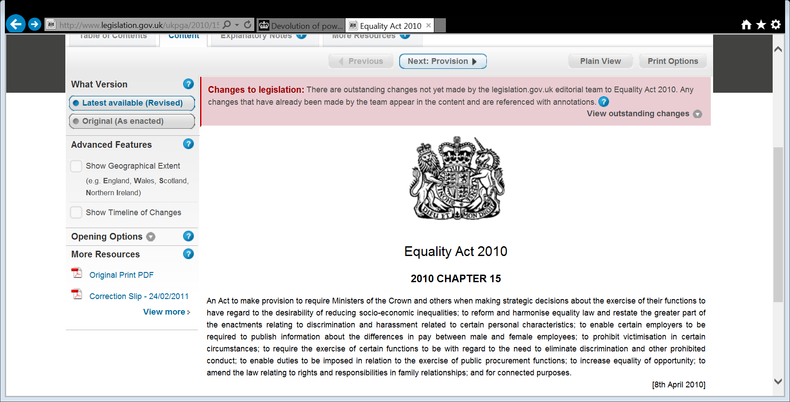
What Does an Act of Parliament Look Like?
Click the following link to explore this Act of Parliament:
https://www.legislation.gov.uk/ukpga/2010/15/contents
Keep this tab open – we’ll come back to it in the second half!

Slide 26

Statutory Interpretation

Slide 27
Statutory Interpretation - An overview
The meaning of the law in a statute should be clear but there may be a need for statutory interpretation due to ambiguity, drafting errors, inadequate expression, technical language, new developments etc.
Whilst Parliament sets the legislation, it is the role of the courts/judges to interpret it.
[Remember the doctrine of separation of powers] The judges must interpret the law as the Parliament intended.
E.g.: imagine a law that said: ‘no vehicles are permitted in London parks.
What is a vehicle? Is it all things with wheels? Only cars and motorbikes with engines? What about push bikes? Are skateboards and roller-skates vehicles? What is the definition of a vehicle? We will work on this later in the Workshop immediately after this lecture.

Slide 28
Rules of Statutory Interpretation or Rules of Construction
Literal Rule
Golden Rule
Mischief Rule
Purposive Interpretation

Slide 29
The Literal Rule of Statutory Interpretation
Under the literal rule, where the words of the statute are plain and unambiguous, you give it its ordinary grammatical meaning - e.g., R v Bentham [2005] UKHL 18
‘Where the meaning of a statute is plain and unambiguous it is not for the judges to invent fancied ambiguities for failing to give effect to its plain meaning because they consider the consequences of doing so would be inexpedient, or even unjust or immoral’ Per Lord Diplock, Duport Steel v Sirs [1980] 1 WLR 142 (HL)
In R v Bentham [2005] UKHL 18 - the question before the court was whether a person who has his hand inside a zipped-up jacket, forcing the material out so as to give the impression that he has a gun, be held to have in his possession an imitation firearm within the meaning of s 17(2) of the Firearms Act 1968?
The appellant was convicted at the Crown Court and the Court of Appeal (Criminal Division) for possession of an imitation firearm, but the SC quashed the appellant’s conviction holding that when the meaning of the statute is plain, the court should give it its ordinary meaning.

Slide 30
Advantages & Disadvantages of the Literal Rule
Where the language of the statute is plain, a judge will give the words their ordinary, literal meaning even if it results in apparent absurdity - See Fisher v Bell [1961] 1 QB 394
Advantages
Promotes certainty in the law.
Avoids usurping parliamentary sovereignty – on the basis that remedy for the ambiguity should be a new or amended statute.
Highlights to Parliament the need for future reform – see subsequent amendment to the Restriction of Offensive Weapons Act 1959 in 1961
Disadvantages
Can lead to an absurd result.

Slide 31
The Golden Rule of Statutory Interpretation
Where the words of the Statute are ambiguous or unclear, or where the ordinary meaning of the words lead to an apparent absurdity with the rest of the Act, the golden rule allows the courts to assume that Parliament intended for those words to have a wider definition than its literal meaning.
So, the rule requires the judges to look at the whole statute, consider its broader purpose and context as well as public policy, and construe the words in a way that gives its true significance and avoid inconsistency, or absurdity.
So, in R v Chief National Insurance Commissioner ex parte Connor [1981] 1 All ER 769, the court took into account public policy considerations and held that the rule against forfeiture applied to disentitle a woman who stabbed her husband to death from receiving a widow’s allowance.
The rule is used to avoid absurd or untenable results that would occur if the literal meaning of the words were applied.

Slide 32
Advantages and Disadvantages of the Golden Rule
Where the ordinary sense of the words leads to an apparent absurdity with the rest of the Act, the ordinary meaning may be modified to avoid the absurdity but no further.
Advantages
Extension of the literal rule and so it still observes parliamentary sovereignty
Court must find genuine difficulties with the literal rule before it can use the golden rule
It is used to avoid absurd or untenable results that would occur if the liberal meaning of the words were applied.
Allows the court to take in to account public policy considerations and balance the law’s broader purpose and context. – See e.g. R v Chief National Insurance Commissioner ex parte Connor [1981] 1 All ER 769
Disadvantages
Can lead to uncertainty

Slide 33
The Mischief Rule of Statutory Interpretation
Where there are difficulties with the wording of the statute the court will look at the mischief the statute was intended to remedy to assist with the interpretation.
In Heydon’s case (1584) 3 Co Rep 7a the mischief rule tries to find out what mischief the legislation was trying to solve by asking the following questions:
What was the Common Law before the Act?
What was the defect/ mischief that the Common Law did not provide for?
What remedy had Parliament decided to apply to cure the defect or mischief?
What was the true reason for the remedy?
This rule allows judges to consider the rationale behind a statute when interpreting ambiguous wordings.

Slide 34
Advantages & Disadvantages of the Mischief Rule
Where there are difficulties with the wording of the statute the court will look at the mischief the statute was intended to remedy to assist with the interpretation.
The rule allows judges to consider the rationale behind a statute when interpreting ambiguous wordings.
Advantages
It is a more flexible rule - See principles in Heydon’s case (1584) 3 Co Rep 7a
  What was the Common Law before the Act?
  What was the defect/ mischief that the Common Law did not provide for?
  What remedy had Parliament decided to apply to cure the defect or mischief?
  What was the true reason for the remedy?
Disadvantages
Judges may give statute words not intended

Slide 35
Purposive Approach to Statutory Interpretation
This rule requires the court to ask: what the true purpose of Parliament was in enacting the statute? This is a modern version of the Mischief Rule in which
Judges are not just identifying any gaps but are looking at what they think Parliament meant to achieve – look at the ‘spirit’ and purpose of the statute
Influenced by EU legislation and the Human Rights Act 1998. E.g. See R v Lambert [2001] UKHL 37 and Pickstone v Freemans PLC [1988] 3 WLR 265
See also: R v Registrar General ex parte Smith (1990) in which the court took a purposive approach and denied a man, who has psychiatric problems, the right to his adoption documents despite the mandatory language of the legislation because he would more than likely kill his biological mother if he received the information.

Slide 36
Vevox #8: The rules of interpretation
Join at: vevox.com
Or vevox.app
ID:116-330-323
In the course of a trial, various arguments are put to the Judge as to the exact meaning of a particular section of a relevant statute. When deciding the case, the judge first looked at the natural ordinary meaning of the words used. However, such an interpretation of those words result in an absurd meaning being given to the section. The judge, therefore, in coming to his decision, interprets the words in a different way which does not result in an absurd meaning

Slide 37

The Use of Hansard - The Rule in Pepper v Hart
The rule in Pepper v Hart states that when primary legislation is ambiguous then, in certain circumstances, the court may refer to statements made in the HoC or the HoL to interpret the meaning of the legislation
When should the courts consult Hansard?
The legislation in question is ambiguous, obscure.
The material relied on consisted of statements by a Minister (or Promoter of the Bill).
The statements relied upon are clear.
Before this ruling, such an action would have amounted to a breach of Parliamentary privilege.
Notes:
.

Slide 38
Other Aids To Interpretation
Extrinsic aids
  Dictionaries
  Textbooks and other reference books
  Earlier statutes (mischief rule)
  Interpretation Act 1978
  Law Commission Reports/Royal Commission and other official commission reports (mischief rule)

Slide 39
Presumptions
A legal presumption is an inference established in law as universally applicable to certain consequences. There is no need to prove the rule or to establish its source.
Some examples:
Presumption against the retrospective operation of statutes.
Presumption against criminal liability without guilty intention. [unless it is expressly stated to be a strict liability offence – where no mens rea is required.]
Presumption against binding the Crown (unless it is explicitly named or by necessary implication). See: Province of Bombay v Municipal Corporation of the City of Bombay [1947] AC 58,; and Lord Advocate v Dumbarton District Council [1990] 2 AC 580, R (on the application of Black) v Secretary of State for Justice [2017] UKSC 81.
Against deprivation of liberty - Sec. of State for the Home Dept ex parte Khawaja [1983] – 2 WLR 321
Presumption of Innocence until proven guilty
Notes:
.

Slide 40
The Impact of the Human Rights Act 1998 on
Statutory Interpretation and Parliamentary Sovereignty
The Human Rights Act 1998 impacts on statutory interpreting and arguably pose threat to Parliamentary Sovereignty.
Section 3, HRA 1998 provides that: ‘So far as is possible to do so, legislation and subordinate legislation must be read and given effect in a way that is compatible with the Convention rights.’ (ECHRs)
All new laws must be drafted in a way which is compatible with human rights listed in the ECHR.
This led some to argue that s.3, HRA 1998 supplants the doctrine of Parliamentary Sovereignty in the UK
Restrictive and Expansive approach to the interpretation and the application of the HRA 1998 [Holland and Webb, Learning Legal Rules (10th ed OUP, 2019)]

Slide 41
Implications of s.3 HRA 1998 to Statutory Interpretation
  The Human Rights Act 1998 brought the rights from the European Convention on Human Rights into UK domestic law and gave people the right to bring claims in UK courts for breach of human rights listed in the ECHR.
This was tested in R v A [2001] UKHL 25; [2002] 2 AC 45 – A rape case.
Facts: In R v A, the accused was charged with rape – wished to bring evidence of previous consensual sexual relations with the complainant but precluded from doing so by s41(1) and (3) of the Youth Justice and Criminal Evidence Act 1999.
Legal issue: The accused argued that the Criminal Evidence Act was in breach of his Art 6 ECHR - Right to a Fair Trial.
The Court agreed.
This means that if the Criminal Evidence Act is interpreted in a way compatible with his right of fair hearing under art. 6 of the ECHR, he would be allowed to bring such evidence.
All public bodies must respect your rights in the ECHR. The Courts can carry out judicial review of executive/agency actions alleged to have breached a person’s ECHR rights.

Slide 42


Slide 43
The Content of an Act
Short title
Royal Coat of Arms
Chapter number
Introductory Text
Date of Royal Assent
Main Body
Headings
Sections
Subsections
Marginal notes
Extent and commencement date
Schedules
Explanatory Memorandum

Slide 44

Thank you for listening!

Slide 45
Lecture-Workshop

Slide 46

A Look at the Structure and Layout of an Act.
Pull up the text of the HRA 1998
Pull up the text of the Equality Act 2010.
Start with the HRA 1998 (then the Equality Act) and do the following exercise:
Examine the structure using the supplied Pdf of the HRA 1998 and identify specific parts of the Act as was listed in slide 43.
Which section provides for Commencement, Subordinate Legislation, and Extent?
Does the Statute bind the Crown?
How many schedules does the Act have?

Slide 47
University Campus Bicycles Act 2017
It shall be an offence punishable by law to leave a bicycle on a university campus outside of a designated storage area.
  A ‘bicycle’ is a two-wheeled vehicle
  A ‘university campus’ is the site on which a university is situated
[Adapt: Fisher v Bell (1960)
The Offensive Weapons Act 1959 made it an offense to sell certain weapons, including flick-knives].

Slide 48

Vevox #9-12: Problem exercise
Apply the four rules of statutory interpretation to each of the following three cases.

Slide 49

Case 1
University Campus Bicycles Act 2017 (Fictitious Act)
It shall be an offence punishable by law to leave a bicycle on a university campus outside of a designated storage area.
  A ‘bicycle’ is a two-wheeled vehicle
  A ‘university campus’ is the site on which a university is situated

Slide 50


Case 2
University Campus Bicycles Act 2017 (Fictitious Act)
It shall be an offence punishable by law to leave a bicycle on a university campus outside of a designated storage area.
  A ‘bicycle’ is a two-wheeled vehicle
  A ‘university campus’ is the site on which a university is situated

Slide 51
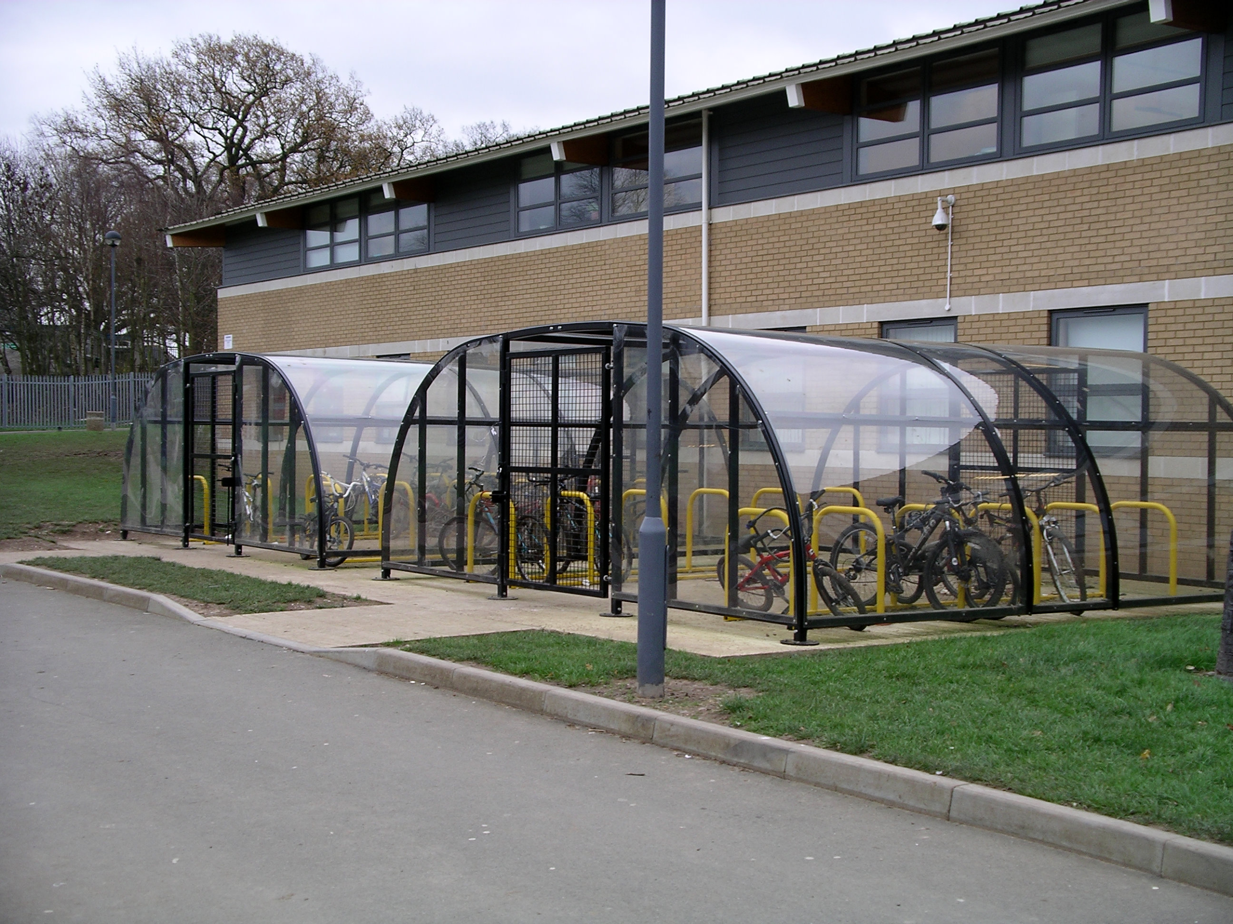

Case 3
University Campus Bicycles Act 2017 (Fictitious Act)
It shall be an offence punishable by law to leave a bicycle on a university campus outside of a designated storage area.
  A ‘bicycle’ is a two-wheeled vehicle
  A ‘university campus’ is the site on which a university is situated

Slide 52

Case 4 - Where can you park legally?

Slide 53

Questions? Thanks for Participating

