Slide 1
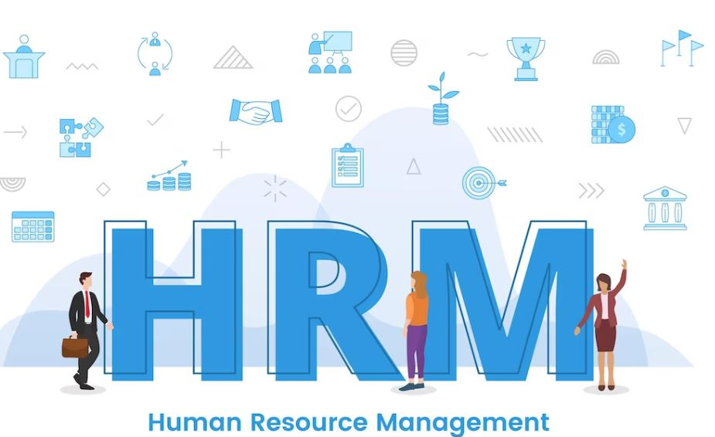
Human Resource Management
Learning Outcome 2
Instructor’s Name

Slide 2
Learning Outcome
“Assessing the contribution of HRM in recruiting and retaining talent and skills to achieve business objectives”

Slide 3
Key Learnings
Resourcing the Organization
Recruitment and Selection
Retention

Slide 4

Importance of HRM in Achieving Business Objectives
The importance of HRM in achieving business objectives cannot be overstated. HRM plays a critical role in attracting and retaining top talent, developing employee skills and capabilities, managing employee performance, and ensuring compliance with employment laws and regulations. By creating a positive work environment, providing development opportunities, and managing performance effectively, HRM helps organizations achieve their objectives and stay competitive in a rapidly changing business environment. Failure to prioritize HRM can lead to poor employee morale, high turnover, and low productivity, which can negatively impact the organization's bottom line.

Slide 5

Resourcing the Organization
“Resourcing the organization is a critical function of HRM and involves a range of activities aimed at ensuring that the organization has the necessary talent and skills to achieve its objectives. This lectures covers some of the key areas involved in resourcing the organization.”

Slide 6
Workforce Planning and Application of Data Analytics
Resourcing the organization is a critical function of HRM and involves a range of activities aimed at ensuring that the organization has the necessary talent and skills to achieve its objectives. This slide covers some of the key areas involved in resourcing the organization.
Workforce planning involves analyzing workforce data to identify trends and forecast future demand for talent and skills.
For instance, a company may use data analytics to identify skill gaps and determine the most effective training programs to close those gaps.
The application of data analytics is crucial in making evidence-based decisions and developing effective workforce strategies.
For example, a company may use workforce planning to analyze historical data and identify trends in employee turnover, such as high turnover rates in specific departments.
Alternatively, data analytics used to identify high-performing employees who are at risk of leaving the organization, allowing HRM to take proactive measures to retain them.

Slide 7
Example
One well-known company that has used workforce planning and data analytics to improve their HRM practices is IBM. IBM used data analytics to identify areas of the business that were facing skill shortages and implemented a strategic workforce planning program to address these gaps.
By analyzing workforce data, IBM was able to identify which skills were in demand and forecast future workforce needs. This information was used to guide the development of talent acquisition and retention strategies, as well as to identify areas for employee development and training.
As a result of their workforce planning efforts, IBM was able to increase employee retention, reduce the time and cost of recruiting new talent, and improve the overall efficiency of their workforce.

Slide 8

Assessing Skills and Capabilities using Audits and Gap Analysis
Assessing
Employee Skills
Identifying
Training Needs
Skills Audit
for Training
Gap Analysis
for Skills
Regular Skills
Assessment
Skills audits and gap analysis involve assessing employee skills and
comparing them
to the skills required for their role or future roles within
the organization
This helps to identify
areas where additional
training or
development is
required
Companies can conduct a
skills audit to identify the
skills and capabilities of their workforce and develop
training programs to close
any skills gaps
Gap analysis can be used to
identify areas where the
organization may be lacking in specific skills or capabilities and take proactive
measures to address those gaps
Regular skills audits and gap analysis are essential for HRM to ensure that their workforce has the skills and knowledge
required to meet the
organization's objectives

Slide 9

Example
An example of a company that has used skills audits and gap analysis to assess their workforce is Walmart. In 2019, Walmart announced a new initiative to train and develop its workforce, including assessing employee skills through a digital platform and offering training programs to close any skills gaps. This initiative aims to upskill Walmart's workforce and prepare them for the jobs of the future, while also meeting the company's business objectives.

Slide 10

Workforce Trends
“Workforce trends, such as flexible working arrangements, remote working, virtual meetings, and social distancing measures, have become increasingly important in recent years, particularly in the wake of the COVID-19 pandemic. HRM plays a critical role in managing these trends and ensuring that they are integrated into the organization's workforce strategy effectively.”

Slide 11
Workforce Trends (Continued)
Flexible Working Arrangements
Flexible working arrangements, such as part-time work, job-sharing, and flexible schedules, have become more prevalent in recent years. This trend has been driven by changing societal attitudes towards work and advancements in technology that allow employees to work from anywhere.
For instance, companies like Deloitte, PwC, and Ernst & Young have introduced flexible working arrangements that allow their employees to work from home or remotely. This has helped these organizations to attract and retain top talent, increase productivity and employee satisfaction, and reduce costs associated with office space and equipment.
Remote Working
Remote working has become a popular trend in recent years, especially in the wake of the COVID-19 pandemic. It has allowed employees to work from anywhere and has eliminated the need for physical office space.
For instance, companies like Twitter, Shopify, and Coinbase have announced that their employees can work remotely indefinitely. This has enabled these companies to expand their talent pool and hire the best candidates from anywhere in the world.
Virtual Meetings
Virtual meetings have become increasingly popular, especially in the wake of the COVID-19 pandemic. They have allowed organizations to conduct meetings with employees and clients from anywhere in the world, reducing travel costs and increasing productivity.
Companies like Microsoft, Google, and Zoom have developed virtual meeting platforms that allow employees to collaborate and communicate effectively, regardless of their location. This has helped organizations to reduce costs associated with travel and office space and has increased productivity.
Social Distancing Measures
Social distancing measures have become increasingly important in recent years, particularly in the wake of the COVID-19 pandemic. HRM plays a critical role in implementing and enforcing these measures to ensure the health and safety of employees.
Companies like Amazon, Walmart, and Target have implemented social distancing measures in their warehouses and stores to protect their employees and customers from COVID-19. This has helped to ensure that these organizations can continue to operate effectively, even during a pandemic.

Slide 12
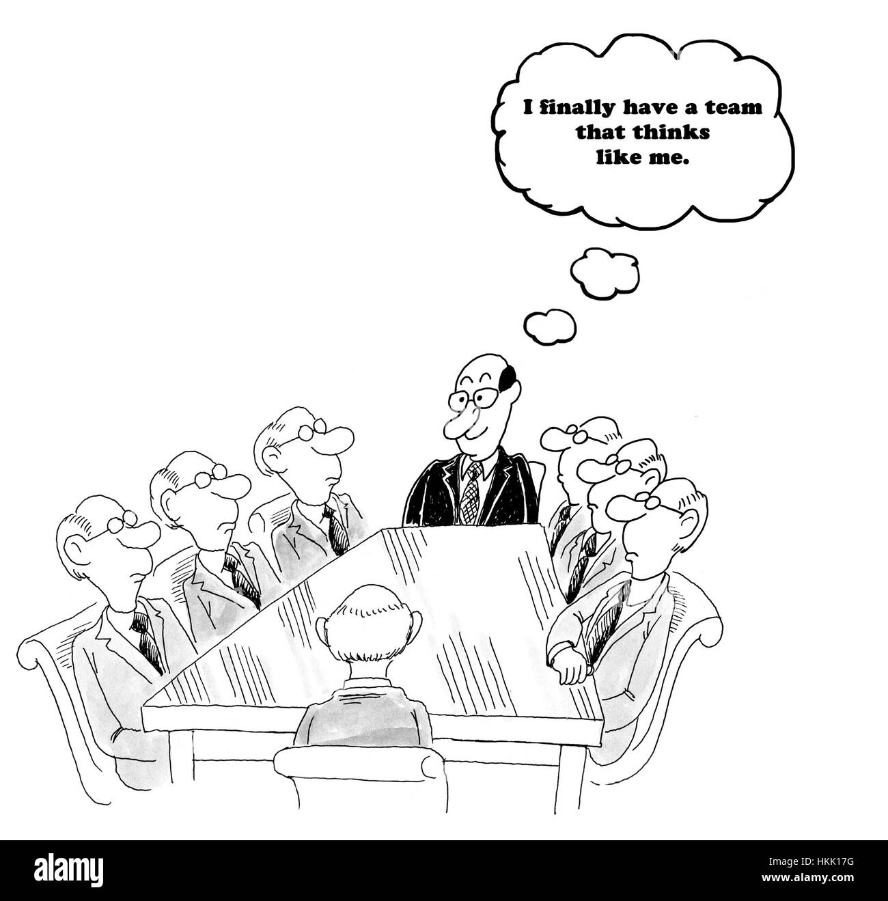
Addressing Diversity and Inclusion
“Diversity and inclusion are crucial for creating a positive work environment and promoting a diverse range of perspectives and experiences within an organization. HRM plays a vital role in creating policies and programs that foster diversity and ensure that recruitment and selection processes are fair and unbiased.”

Slide 13
Addressing Diversity
and Inclusion
Why Diversity and Inclusion Matter
A diverse workforce promotes innovation and creativity by bringing together different perspectives and experiences.
A culture of inclusion fosters a positive work environment, improves employee morale and productivity, and reduces turnover.

Slide 14
HRM's Role in Addressing Diversity and Inclusion
Developing and implementing policies and programs that promote diversity and inclusion, such as diversity training and mentoring programs.
Ensuring that recruitment and selection processes are fair and unbiased, including avoiding discrimination based on age, gender, race, ethnicity, religion, sexual orientation, or disability status.
Creating a culture of inclusion by encouraging open communication, respect, and understanding among employees.
Addressing Diversity
and Inclusion

Slide 15
Examples of Diversity and Inclusion Programs
Providing diversity and inclusion training for all employees, including managers and executives.
Developing affinity groups for underrepresented groups, such as women or people of color, to support networking and career development.
Offering flexible work arrangements, such as part-time or remote work options, to accommodate diverse employee needs.
Ensuring that job descriptions and requirements are inclusive and do not unnecessarily exclude qualified candidates from underrepresented groups.
Addressing Diversity
and Inclusion

Slide 16
Types of Labor Market and Skills Shortages Affecting Recruitment
“Recruiting and retaining top talent is becoming increasingly difficult due to the changing labor
market and skills shortages in various areas.”
The labor market is subject to changes based on the economic, social, and political conditions
prevailing in a region or country. These trends can have a direct impact on recruitment, as
organizations may struggle to find suitable candidates for open positions.
Some examples of labor market trends are:
Low Unemployment Rates
Aging Workforce
Gig Economy
When unemployment rates are low, it becomes challenging to attract qualified candidates, and competition for top talent increases.
With a growing aging workforce, many organizations are struggling to fill vacancies with skilled workers.
The rise of the gig economy has resulted in a shift in the way people view work. More workers are seeking flexible work arrangements, making it challenging for organizations to attract and retain full-time staff.

Slide 17
Skills Shortages
“Skills shortages occur when there is a lack of qualified candidates for specific roles or areas.”
Some skills shortages that are affecting recruitment and retention of top talent include:
Digital Skills
Leadership Skills
Data Analytical Skills
With the increasing digitization of the workplace, there is a growing demand for workers with skills in areas like data analytics, cloud computing, and cybersecurity.
The ability to lead and manage people effectively is crucial for organizations, but many struggle to find qualified candidates with these skills.
As data becomes more critical in decision-making processes, the demand for workers with strong analytical skills is growing.

Slide 18
Addressing Skills Shortages
“HRM plays a crucial role in addressing skills shortages and ensuring that the
organization has the talent it needs.”
Some strategies that HRM can use include::
Partnering with educational institutions to offer training programs that develop the skills needed by the organization.
Offering on-the-job training and development programs that focus on specific skills.
Implementing flexible work arrangements and other incentives to attract and retain top talent.

Slide 19
Example
An example of types of labor market and skills shortages affecting recruitment is the shortage of cybersecurity professionals. With the increasing number of cybersecurity threats, there is a growing demand for cybersecurity professionals. However, there is a shortage of skilled workers in this field, making it difficult for companies to fill their cybersecurity positions. This shortage is attributed to the fast-changing nature of cybersecurity threats and the lack of formal cybersecurity education and training programs. As a result, many organizations are struggling to find qualified candidates to fill their cybersecurity roles.

Slide 20

Impact of Relevant Legislation on HRM
HRM responsible for ensuring compliance with employment laws and regulations.
Examples: Equal Employment Opportunity laws, Fair Labor Standards Act, Family and Medical Leave Act
HRM must comply with data protection laws when handling employee data
Examples: General Data Protection Regulation (GDPR), California Consumer Privacy Act (CCPA)
Failure to comply with employment laws and data protection legislation can result in legal and financial consequences
Examples: Fines, lawsuits, loss of business, damage to reputation
Employment Laws and Regulations
Data Protection Legislation
Consequences of Non-Compliance

Slide 21
Example
In 2018, Google was fined €50 million by French data protection authorities for breaching GDPR regulations. The company failed to provide adequate transparency and consent mechanisms for users' data and did not have a valid legal basis for processing personal data for advertising purposes. This case highlights the importance of complying with data protection legislation and the potential consequences of non-compliance.

Slide 22
Recruitment and Selection
“Recruitment and selection are critical functions of HRM that require effective models to guide the process.”

Slide 23
Models of Recruitment and Selection
Traditional Model
The traditional recruitment and selection model involves posting job advertisements, receiving resumes, and conducting interviews with potential candidates.
Example
Posting job ads on job boards, newspapers, and online job
portals.
Social Media Model
The social media model involves using social media platforms, such as LinkedIn, Facebook, and Twitter, to advertise job vacancies, search for potential candidates, and engage with job seekers.
Example
Using LinkedIn to search for
candidates and promote job
vacancies.
Competency-based Model
The competency-based model focuses on identifying and selecting candidates based on their specific competencies, knowledge, and skills.
Example
Administering a skills test or
work sample test during the
selection process.

Slide 24
Sources of Recruitment
“Recruitment sources refer to the methods used by organizations to attract potential candidates for open positions. In general, recruitment sources can be categorized into internal and external sources.”

Slide 25
Internal Recruitment Sources
Promotion
Promoting employees from within the organization to a higher position. This is beneficial as it reduces training costs and is motivating for employees.
Internal Advertisement
Posting job vacancies within the organization, making it accessible to existing employees. This source encourages existing employees to apply for positions of their interest.
Job Rotation
A process of moving employees from one department to another department. This provides employees with a diverse experience of different areas of work within the organization.
Employee Referrals
Existing employees refer potential candidates for open positions. This can be a cost-effective source of recruitment and can lead to good quality candidates.

Slide 26
External Recruitment Sources
Advertising
Online Job
Portals
Campus
Recruitment
Recruitment
Agencies
Social Media
Advertising open
positions through
job boards,
newspapers,
industry publications, and other media
outlets.
Organizations use online job portals such as LinkedIn, Indeed, and Glassdoor to
reach a large pool of candidates.
This source targets students and graduates from colleges and universities. It is an
effective method to
recruit fresh talent.
Organizations can
hire recruitment
agencies to find
suitable candidates
for the job
position. These
agencies can provide a pool of talented
and pre-screened
candidates.
Social media
platforms such as
Facebook, Twitter,
and Instagram are
also becoming
popular sources of
recruitment.

Slide 27
Achieving Cultural Diversity in Recruitment
“Cultural diversity is crucial for organizational success as it promotes inclusivity and brings different perspectives to the workplace.
In recruitment, HRM plays a critical role in ensuring that the organization has a diverse workforce.”

Slide 28
Achieving Cultural Diversity in Recruitment (Cont)
Inclusive Recruitment Practices
Training on Diversity and Inclusion
Partnerships with Diverse Organizations
Examples
Job postings should be written in a way that attracts candidates from diverse backgrounds.
Recruitment teams should be trained in diversity and inclusion practices to ensure a fair and unbiased hiring process.
Blind resume screening and interview processes can help eliminate biases during the selection process.
Unilever: The company has implemented an inclusive recruitment strategy to attract diverse candidates. They have created partnerships with diversity and inclusion organizations and use social media platforms to reach candidates from diverse backgrounds.
Starbucks: Starbucks has partnerships with community-based organizations to attract candidates from diverse backgrounds. They also have an online training program on diversity and inclusion that all employees are required to complete.
Training on diversity and inclusion can help create awareness and understanding of different cultures, values, and beliefs.
Diversity training can also help identify and eliminate unconscious biases during the recruitment and selection process.
Establishing partnerships with diverse organizations, such as minority business groups, can help increase the pool of qualified candidates from diverse backgrounds.
Participating in diversity job fairs and events can also help promote the organization's commitment to diversity and inclusion.

Slide 29
Stages in Recruitment and Selection
This stage involves identifying the skills, knowledge, and qualifications required for a particular job. It is essential to have a clear understanding of the job to attract suitable candidates.
Job Analysis
Attracting
Candidates
This stage involves advertising the job vacancy through various channels, such as job boards, social media, career fairs, and employee referrals.
This stage involves reviewing resumes and applications to shortlist suitable candidates for further assessment. This stage also involves conducting initial interviews and assessments to narrow down the candidate pool.
Screening
Candidates
Selecting
Candidates
This stage involves conducting more in-depth interviews, assessments, and reference checks to identify the most suitable candidate for the job.
This stage involves extending the job offer to the selected candidate and finalizing the terms and conditions of employment.
Hiring
Candidates

Slide 30
Example
“Examples of stages in recruitment and selection may vary based on the organization's size, structure, and industry. However, these stages generally form the core of the recruitment and selection process.”

Slide 31
Types of Selection Methods
“Selecting the right candidate is crucial for the organization's success, and HRM has various selection methods to choose from. Different types of selection methods are used to evaluate candidates' suitability for the job.”

Slide 32
Types of Selection Methods
Interviews are commonly used to assess candidates' interpersonal skills, communication skills, and cultural fit.
Different types of interviews, such as structured, unstructured, and behavioral interviews, can be used to evaluate candidates.
Psychometric tests are used to assess candidates' cognitive abilities, personality traits, and emotional intelligence.
They can provide insight into how candidates may perform on the job.
Work sample tests evaluate candidates' ability to perform tasks similar to those required for the job.
They can provide a more realistic assessment of candidates' skills and abilities.
Application forms
gather information
about candidates’
education,
experience, and
skills relevant to the
job.
They can be used to pre-screen candidates and identify those
who meet the
minimum
qualifications.
Assessment centers evaluate candidates' skills and competencies using various methods, such as group exercises, case studies, and role plays.
Assessment centers provide a more comprehensive evaluation of candidates' abilities and are typically used for higher-level positions.
Competence-based selection focuses on identifying the specific competencies required for the job and assessing candidates' ability to demonstrate these competencies.
This method ensures that candidates are selected based on their ability to perform the job tasks.
Application Forms
Interviews
Assessment
Centers
Psychometric
Tests
Work Sample
Tests
Competence-based Selection

Slide 33
Example
A software company may use coding tests as a work sample test to evaluate candidates' programming skills.
A retail company may use personality tests as a psychometric test to assess candidates' customer service orientation.
An assessment center may be used by a consulting firm to evaluate candidates' analytical skills and teamwork abilities for a management consulting position.

Slide 34
Legal Frameworks and Regulatory Standards
“HRM is responsible for ensuring compliance with legal frameworks and regulatory standards to avoid legal and financial consequences and protect the organization's reputation.”

Slide 35
Legal Frameworks and Regulatory Standards
Equal Employment
Opportunity Laws
Equal employment opportunity laws ensure that job candidates are not discriminated against based on their race, gender, age, religion, or disability.
HRM must ensure that recruitment and selection practices are free from any bias or discrimination.
Example
A company ensures that job postings use inclusive language and that recruitment teams receive diversity and inclusion training to eliminate any bias or discrimination.
Data Protection
Laws
Data protection laws regulate the collection, use, and storage of personal information.
HRM must obtain candidates' consent to collect and use their personal data and ensure that it is stored securely.
Example
A company obtains candidates' consent to collect and use their personal information and ensures that it is stored securely, in compliance with data protection laws.
Health and Safety
Regulations
Health and safety regulations aim to protect employees from work-related injuries and illnesses.
HRM must ensure that recruitment and selection processes are designed to identify candidates who can work safely and comply with health and safety regulations.
Example
A company assesses candidates' ability to work safely during the selection process and provides training on health and safety regulations for new employees.

Slide 36
Retention
“Employee retention is the process of keeping employees engaged and committed to the organization.
Retaining top talent is essential for organizational success, as it reduces turnover costs and improves productivity.”

Slide 37
Retention (Cont)
Managing Attrition,
Restructuring, and Redeployment, Redundancy of Employees
Factors Influencing
Retention
Factors that influence employee retention include job satisfaction, work-life balance, career development opportunities, competitive compensation and benefits, and a positive work environment.
HRM must develop strategies to manage attrition, restructuring, and redundancy, which may include offering voluntary exit programs, redeploying employees to other roles, and providing outplacement services.
Onboarding and
Induction
Dealing with Employee Disciplinaries and Misconduct Cases
that End in Dismissal
Effective onboarding and induction programs can help new employees feel welcome, understand their role and responsibilities, and become integrated into the organization's culture.
HRM must follow proper procedures and legal
frameworks when dealing with employee
disciplinary and misconduct cases that may result in dismissal. This includes conducting a fair and
thorough investigation, providing the employee
with an opportunity to respond, and ensuring that the decision is based on clear and objective
criteria.
Role of Line Managers in
Employee Engagement and
Performance Management
Examples
A company may offer flexible working arrangements, such as telecommuting or flexible hours, to improve work-life balance and retain employees.
A manager may provide regular feedback and recognition to employees to improve engagement and performance.
In a restructuring scenario, HRM may offer training and development opportunities to employees to help them transition to new roles within the organization.
HRM may work with legal advisors to ensure that employee disciplinary procedures are followed correctly and fairly.
Line managers play a crucial role in employee engagement and performance management by providing regular feedback, coaching, and recognition to their team members.

Slide 38
Summary
Workforce planning and data analytics
Audits and gap analysis for identifying talent and skill gaps
Workforce trends (e.g. flexible working, remote working, social distancing)
Addressing diversity and inclusion
Types of labor market and skills shortages
Recruitment and selection:
Different models of recruitment and selection
Sources of recruitment (internal vs. external)
Achieving cultural diversity in recruitment
Stages in recruitment and selection
Different types of selection methods (competence-based)
Legal frameworks and regulatory standards
Retention:
Factors influencing retention
Onboarding and induction
Role of line managers in employee engagement and performance management
Managing attrition, restructuring, and redundancy
Dealing with employee disciplinaries and misconduct cases.

Slide 39
Thanks !

