Slide 1
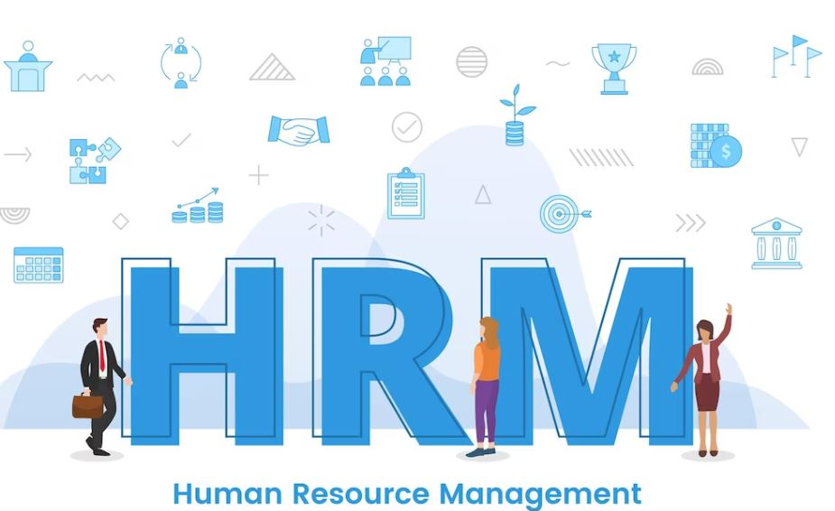
Human Resource Management
Learning Outcome 3
Instructor’s Name

Slide 2
Learning Outcome
“Examine how External and Internal Factors can Influence HRM Decision
making in Relation to Organizational Development”

Slide 3
Key Learnings
External Factors Influencing HRM Decision Making
Internal Factors Influencing HRM Decision Making
Organizational Development

Slide 4

External Factors Influencing HRM Decision Making

Slide 5

Impact of External Factors on Organizational Performance
Economic conditions such as recession or growth can impact organizational performance
Changes in consumer behavior and demand can also impact organizational performance
Example: During the COVID-19 pandemic, many organizations had to quickly adapt to remote work and changes in consumer behavior, which impacted their performance.

Slide 6
Skills Gaps and Labor Force Trends
The availability of skilled workers can impact HRM decision making
Labor force trends such as aging workforce or changes in the job market can also impact HRM decisions
Example: A shortage of skilled workers in a particular industry may lead to HRM decisions such as investing in training and development programs to upskill current employees.

Slide 7
Impact of Globalization on HR Policies for Equality, Diversity and Cultural
Awareness
Globalization has led to increased diversity in the workplace and the need for HR policies that support equality and cultural awareness
Examples of HR policies include diversity training, equal opportunity hiring practices, and language support for non-native speakers.
Example: A multinational organization may have HR policies in place that support diversity and cultural awareness in different regions where they operate.

Slide 8
Impact of Legal and Regulatory Frameworks
Laws and regulations related to employment can impact HRM decisions
Examples of regulations include minimum wage laws, equal employment opportunity laws, and workplace health and safety regulations.
Example: HRM decisions related to hiring, compensation, and workplace safety must comply with relevant laws and regulations in a particular jurisdiction.

Slide 9

Internal Factors Influencing HRM Decision Making

Slide 10

Impact of Leadership Styles on Organizational Transformation, Culture and Employee Experience
Leadership styles can impact organizational culture and employee experience
Transformational leaders can inspire employees and promote change, while autocratic leaders may stifle creativity and innovation
Example: An organization with a culture of innovation may benefit from a transformational leadership style that encourages experimentation and risk-taking.

Slide 11

Learning and Development: How People Learn and Impact of Digital Learning
Effective learning and development programs can improve employee skills and performance
Digital learning technologies can provide new opportunities for employee training and development
Example: A company may use online training modules or virtual reality simulations to train employees in new skills or to improve existing ones.

Slide 12

The Relationship Between Organizational Culture and Strategic Planning and Development
Organizational culture can impact strategic planning and development
A strong culture of innovation may encourage experimentation and the development of new products or services
Example: An organization with a culture of continuous improvement may develop a strategic plan that focuses on incremental improvements in existing products or services.

Slide 13
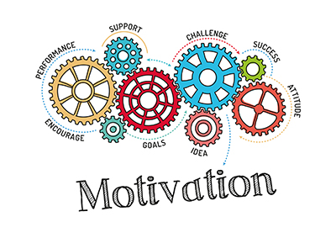
Impact of Motivation Upon Performance
Motivated employees are more productive and engaged in their work
HRM decisions related to compensation, benefits, and recognition can impact employee motivation
Example: An organization that offers competitive salaries, benefits, and opportunities for recognition may have a highly motivated
workforce.

Slide 14

Organizational Development

Slide 15

The Changing Work Environment and the Need for Flexible Organizations
Organizations need to be adaptable to changes in the business environment
A flexible organization can respond quickly to changes in customer demands or market conditions
Example: During the COVID-19 pandemic, organizations had to quickly adapt to remote work and changes in customer behavior, highlighting the need for flexibility.

Slide 16

Characteristics of Agile Organizations
Agile organizations are adaptable, responsive, and innovative
They prioritize collaboration, communication, and teamwork
Example: A software development company that uses agile methodologies to deliver products quickly and respond to changing customer needs.

Slide 17
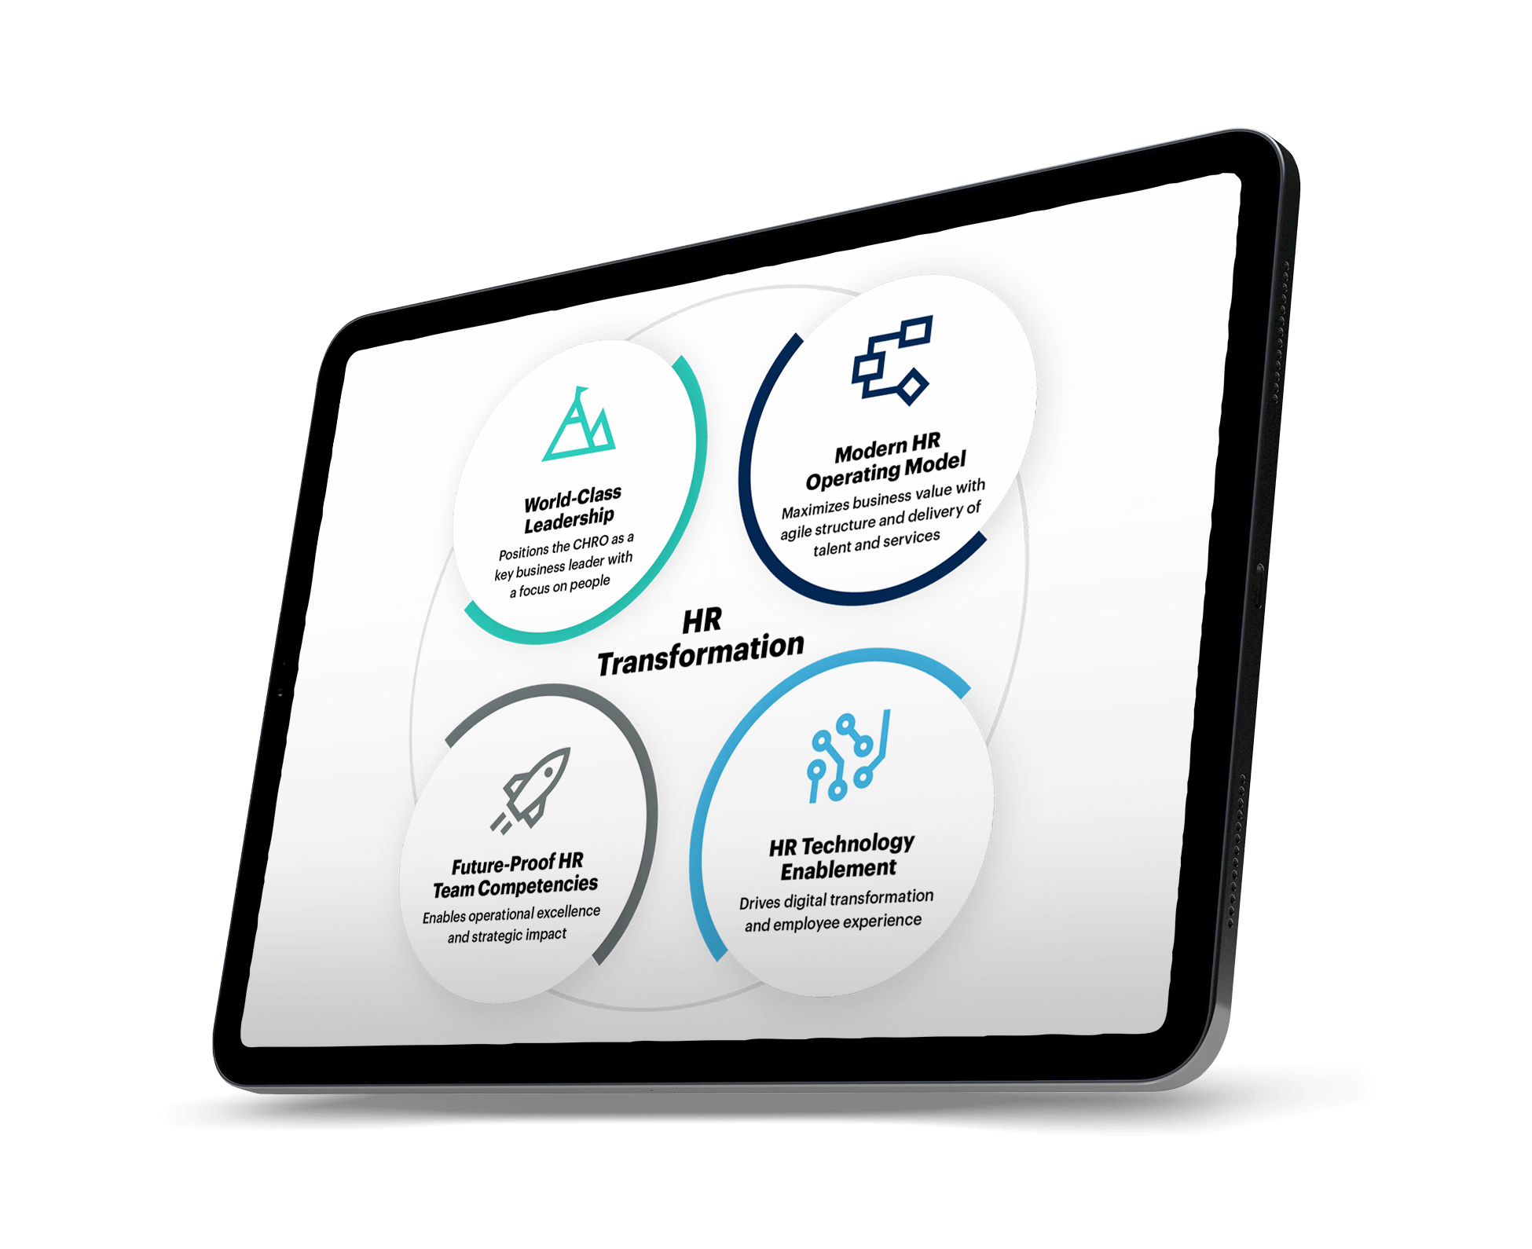
Characteristics of Agile Organizations
HR functions are increasingly relying on digital technologies to improve efficiency and effectiveness
Technologies such as reporting dashboards and predictive analytics can help HR professionals make data-driven decisions
Example: An HR department that uses a reporting dashboard to monitor employee performance metrics such as absenteeism and turnover.

Slide 18

Artificial Intelligence (AI) for Talent Acquisition
AI can assist with various HR functions, including talent acquisition
AI-powered recruiting tools can help identify top candidates and improve the hiring process
Example: A company that uses AI-powered software to screen resumes and identify the most qualified candidates for a job opening.

Slide 19

Characteristics of Agile Organizations
Cloud-based technologies can provide HR professionals with real-time data on team performance and help calibrate decision making
Cloud capabilities can also facilitate remote work and collaboration
Example: An HR department that uses cloud-based project management software to track team performance and make data-driven decisions.

Slide 20
Summary
External factors that influence HRM include the impact on organizational performance, such as skills gaps and labor force trends.
Globalization affects HR policies for equality, diversity, and cultural awareness.
Legal and regulatory frameworks also impact HRM decision making.
Internal factors include the impact of leadership styles on organizational transformation, culture, and employee experience.
Learning and development, including digital learning, also affect HRM decisions.
The relationship between organizational culture and strategic planning and development is crucial.
Motivation impacts employee performance, making it a key factor in HRM decision making.
Organizational development requires adaptable and flexible organizations that prioritize collaboration, communication, and innovation.
Digital transformation of HR functions through technologies such as reporting dashboards, predictive analytics, AI, and cloud capabilities can improve efficiency and effectiveness.

Slide 21
Thanks !

