Slide 1

Human Resource Management
Learning Outcome 4
Instructor’s Name

Slide 2
Learning Outcome
“Apply HRM Practices in a work-related context for improving Sustainable
Organizational Performance.”

Slide 3
Key Learnings
Job Descriptions and Person Specification
Recruitment and Selection in Practice
Performance Management
Employee
Relationship

Slide 4

Job Descriptions and Person Specification

Slide 5
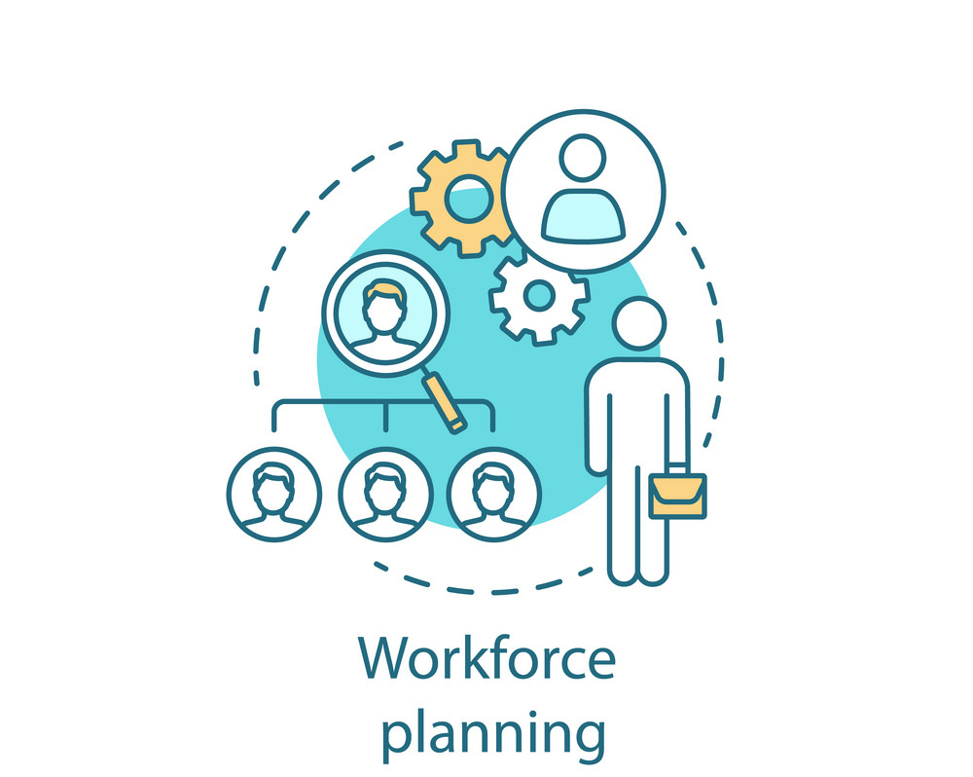
Workforce Planning
“Workforce planning is the process of identifying and addressing gaps between the current workforce and future business needs. It involves forecasting workforce needs, analyzing the current workforce, and developing strategies to address any gaps or deficiencies. Workforce planning is important for HRM because it helps organizations to align their workforce with their strategic objectives, improve organizational performance, and ensure that they have the right people with the right skills in the right roles at the right time.”

Slide 6

Assessing the need to
Create and Fill a Post
Assessing the need to create and fill a post is an important step in workforce planning. This involves evaluating the current workforce to determine if there are any gaps or deficiencies that need to be addressed. For instance, if an organization is expanding its operations or launching a new product, it may need to hire additional staff to support these initiatives. On the other hand, if an organization is downsizing or reorganizing, it may need to reduce its workforce.

Slide 7
Factors to consider when developing workforce plans include:
Business Strategy
1
The organization's strategic objectives and priorities should be considered
when developing workforce plans. This will help to ensure that the workforce is
aligned with the organization's goals and
priorities
2
Workforce Development
Workforce development involves providing employees with the training and development they need to perform their roles effectively and prepare them for future roles within the organization. This can help to improve employee engagement and retention, as well as the organization's overall performance.
Workforce Analysis
3
This involves analyzing the current workforce to determine if there are any gaps or deficiencies
that need to be addressed. This analysis may
include an assessment of employee skills,
knowledge, and experience, as well as an
evaluation of workforce demographics, such as
age, gender, and diversity.
4
Workforce Flexibility
Organizations need to be flexible and adaptable to changes in the business environment. This may involve cross-training employees to perform multiple roles, hiring temporary or contract workers during peak periods, or outsourcing certain functions.
Succession Planning
5
Succession planning involves identifying key
positions within the organization and developing
plans for filling those positions in the event of
retirement, resignation, or another turnover. This
can help to ensure continuity of operations and
minimize disruptions caused by turnover.

Slide 8

Job Descriptions
“Job descriptions are written statements that describe
the duties, responsibilities, and requirements of a particular job. They are an important tool for HRM because they
help to clarify expectations and communicate
information about the job to potential candidates, employees, and managers.”

Slide 9

The importance of Job Descriptions includes:
01.
02.
03.
Clarity
Recruitment
Performance Management
A well-written job description provides clarity about the expectations and requirements of a particular job. This can help to reduce misunderstandings and improve job performance.
Job descriptions are an important tool for recruiting candidates. They can be used to communicate the requirements of the job and attract qualified candidates.
Job descriptions can be used as a basis for performance evaluations. They provide a clear understanding of the duties and responsibilities of the job, which can be used to assess performance.

Slide 10

There are two types of job descriptions - competence-based and task-based.
Competence-based job descriptions focus on the knowledge, skills,
and abilities required to perform the job. They describe the competencies or qualities that a successful candidate should possess.
Competence-based job descriptions are useful when recruiting for
roles where technical or specialized skills are required.
For example, a job description for a software developer may include
requirements such as programming skills, experience with specific
programming languages, and knowledge of software development methodologies.
Task-based job descriptions focus on the specific tasks and duties required to perform the job. They describe the day-to-day
responsibilities of the job and the tasks that need to be completed.
Task-based job descriptions are useful when recruiting for roles where a specific set of tasks needs to be completed.
For example, a job description for a receptionist may include tasks
such as answering phones, greeting visitors, and scheduling
appointments.
Assessing the merits of each type of job description depends on the
specific requirements of the job. Competence-based job descriptions
are useful for technical or specialized roles where specific skills or
knowledge are required. Task-based job descriptions are useful for roles where a specific set of tasks need to be completed. It is also possible to use a combination of both types of job descriptions, depending on the needs of the job.
Data analytics helps HR professionals make
informed decisions about talent management,
recruitment, performance management,
employee engagement, and other HR processes.

Slide 11

Person Specification
“A person specification is a document that outlines
the qualifications, skills, knowledge, experience, and personal attributes required for a particular job role. It is an important tool for HRM because it helps to
identify the ideal candidate for the job and provides a clear basis for recruitment and selection decisions.”
The importance of a person specification includes:
Recruitment - A person specification helps to identify the ideal candidate for the job, which can help to attract qualified candidates.
Selection - A person specification provides a clear basis for selection decisions. It helps to ensure that the most qualified and suitable candidate is selected for the job.
Performance Management - A person specification can be used as a basis for performance evaluations. It provides a clear understanding of the skills, knowledge, and attributes required for the job, which can be used to assess performance.
Data analytics helps HR professionals make
informed decisions about talent management,
recruitment, performance management,
employee engagement, and other HR processes.

Slide 12
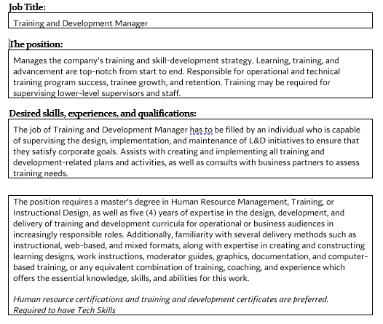
For example, a person specification for a Training and Development might include requirements such as:

Slide 13

Recruitment and Selection
“Recruitment and selection are critical HRM practices that involve identifying, attracting, and selecting the most suitable candidate for a job role.”
The importance of recruitment and selection in HRM includes:
Acquiring Talent - Recruitment and selection help organizations to attract and acquire the right talent for their needs..
Retaining Talent - By selecting the right candidate, organizations can reduce the likelihood of high turnover rates, which can be costly and time-consuming.
Boosting Productivity - Hiring the right candidate for the job can result in improved productivity and performance, which can benefit the organization as a whole.

Slide 14
To successfully recruit and select the right candidate, HRM must:
01.
02.
03.
04.
Design and Place Job Advertisements
Shortlisting and Processing Applications
Selection Best Practice
Interview Preparation and Best Practices
HRM must create job advertisements that are clear, concise, and attractive to potential candidates. The advertisement should include essential job requirements, responsibilities, and qualifications.
HRM should ensure that they have effective methods of screening job applications to identify the most suitable candidates. The screening process can include a review of CVs, cover letters, and initial interviews.
HRM should provide appropriate training to managers to conduct effective interviews. They should ensure that interviews are structured and fair, and that all candidates are assessed on the same criteria.
HRM must establish a clear and transparent process for selecting candidates. This should involve setting objective criteria for selecting candidates, such as qualifications, experience, and skills.

Slide 15
For example, a selection process for a marketing manager role may involve the following:
The HRM team
develops a clear and concise job
description and
person
specification.
They design and place job
advertisements
on relevant job
boards and social media
platforms.
They review applications and shortlist candidates based on objective
criteria.
They select the
most suitable candidate based on
the objective
criteria and make a job offer.
They conduct in-depth
interviews with shortlisted candidates, assessing
their knowledge, skills, and experience, and asking behavioral-based
interview questions.
They conduct
initial screening interviews to further assess the candidates.

Slide 16

“Performance management is a
critical HRM practice that involves setting performance objectives,
assessing employee performance, and providing feedback and support to improve employee
performance.”
Performance Management

Slide 17
Performance Management (Cont)
The importance of performance management in HRM includes:
Aligning Employee Performance to Organizational Goals - Performance management aligns employee performance with the organization's goals and objectives. By setting clear performance objectives, employees understand how their contributions impact the overall success of the organization.
Identifying and Addressing Performance Gaps - Performance management helps identify employee performance gaps and provides feedback and support to help employees improve their performance.
Developing and Retaining Employees - Performance management provides opportunities for employee development and growth. By providing feedback and support, employees can develop their skills and advance their careers within the organization.
Enhancing Employee Engagement - Performance management can increase employee engagement and motivation by recognizing and rewarding high performance and providing opportunities for development and growth.

Slide 18
Performance Management (Cont)
To effectively manage employee performance, HRM must:
Align Performance Management with Workforce Planning - Performance management should be aligned with the organization's workforce planning goals and objectives. This ensures that employees are working towards the organization's strategic goals and objectives.
Use a Mix of Financial and Non-Financial Rewards - Performance management should include a mix of financial and non-financial rewards, such as salary increases, bonuses, promotions, and recognition programs.
Offer Staff Development Opportunities - Performance management should include opportunities for staff development, such as continuous professional development and training programs. This enables employees to enhance their skills and knowledge and advance their careers within the organization.
Provide Support and Maintain Employee Well-being - Performance management should also include support for employees, such as mentoring, coaching, and counseling. This can help employees manage their workload and maintain their well-being.

Slide 19

Personal Development Planning
“Personal Development Planning (PDP) is an HRM practice that involves creating a structured plan for an employee's career development. PDP helps employees identify their strengths and weaknesses, set goals, and develop the skills and knowledge needed to achieve those goals.”

Slide 20
Personal Development Planning
(Cont)
The importance of PDP in HRM includes:
Encouraging Lifelong Learning - PDP encourages employees to continue learning and developing their skills throughout their career. This can enhance their job performance and help them adapt to changing work environments.
Supporting Career Development - PDP provides a framework for employees to plan their career development within the organization. By identifying their strengths and weaknesses and setting career goals, employees can take steps to advance their careers and achieve their professional aspirations.
Enhancing Job Satisfaction - PDP can enhance job satisfaction by providing employees with a clear understanding of their career path within the organization and the steps they need to take to achieve their goals.

Slide 21
Personal Development Planning
(Cont)
To effectively implement PDP, HRM must:
Embed Learning and Reflective Practice - PDP should include opportunities for employees to reflect on their learning and development and identify areas for improvement. This can help employees develop a growth mindset and a commitment to continuous learning.
Manage Underperformance - PDP should also include strategies for managing underperformance, such as identifying areas for improvement and providing support and training to help employees improve their performance.
Handle Disciplinary, Industrial Disputes, and Grievance Procedures - HRM should also have clear procedures in place for managing disciplinary issues, industrial disputes, and grievances. This can help maintain a positive workplace culture and ensure fair treatment of all employees.
Plan for Succession - PDP should include succession planning, where employees are identified as potential successors for key roles within the organization. This can ensure continuity of leadership and minimize disruptions to business operations.

Slide 22
For example, a PDP process for an employee in a marketing role may include:
The employee and their manager identify the employee's strengths and weaknesses, as well as their career aspirations.
The HRM team provides support and resources for the employee's development, such as training programs and coaching.
The employee and their
manager create a development
plan that includes specific goals and action steps, such as
attending training courses,
taking on new responsibilities,
and seeking mentorship.
Succession planning is also considered, with the employee
identified as a potential
successor for key marketing
roles within the organization.
Overall, effective PDP practices can help employees develop
their skills and knowledge,
advance their careers, and
contribute to the overall
success of the organization.
The employee regularly reflects on their progress towards their goals and receives feedback from their manager.

Slide 23

Employee Relationship
The employment relationship is the bond between an employer and an employee, which establishes the rights, responsibilities, and expectations of both parties.
A positive employment relationship can result in a highly engaged and committed workforce, while a negative one can lead to high turnover rates, low morale, and low productivity.
For example, if an employer fosters a positive work environment, provides opportunities for career development, and recognizes employee contributions, employees are more likely to be engaged, committed, and motivated.

Slide 24
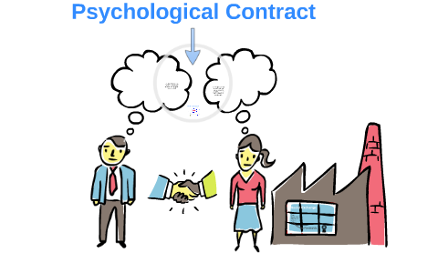
The Psychological Contract
The psychological contract is the unwritten, informal expectations and obligations between an employer and an employee.
It can include factors such as job security, career development opportunities, work-life balance, and recognition and rewards.
For example, if an employee expects job security and career development opportunities in exchange for their commitment to the organization, and the employer fails to provide these, the employee may feel dissatisfied and disengaged.

Slide 25

Employee Voice and Engagement
Employee voice refers to the opportunities and mechanisms provided by the employer for employees to express their opinions, concerns, and suggestions regarding work-related matters.
Employee engagement refers to the level of commitment, motivation, and satisfaction that employees have towards their job and organization.
For example, if an employer provides opportunities for employees to participate in decision-making, seeks and values employee feedback, and recognizes and rewards employee contributions, employees are more likely to be engaged, committed, and motivated.

Slide 26

Managing Performance to Attain Competitive Advantage and Increase Job Satisfaction
Performance management is a continuous process of setting goals, monitoring progress, and providing feedback to employees.
Employers can manage employee performance by providing regular feedback, setting clear expectations and goals, providing training and development opportunities, and recognizing and rewarding employee achievements.
For example, if an employer provides regular feedback and coaching to employees, and recognizes and rewards high-performing employees, they are more likely to be motivated, engaged, and committed to achieving organizational goals.

Slide 27
Summary
HRM practices play a crucial role in improving sustainable organizational performance.
Job descriptions and person specifications are important tools in workforce planning and identifying the right candidates for the job.
Competence-based and task-based job descriptions have their merits and should be assessed accordingly.
Designing a relevant person specification involves identifying qualities and attributes necessary for a job role.
Recruitment and selection involve designing and placing job advertisements, shortlisting and processing applications, and conducting interviews and selection based on best practices.
Performance management involves aligning goals with workforce planning, using financial and non-financial rewards, and promoting staff development and wellbeing.
Personal development planning should embed learning and reflective practice, and also address underperformance, disciplinary issues, and succession planning.
Employee relationship management should focus on the psychological contract, employee voice and engagement, and managing performance for competitive advantage and job satisfaction.

Slide 28
Thanks !

