Slide 1
Lecture 1 – Introduction to the Principles of Criminal Law
– Criminal Law
Prepared by Barrister Syeda Sakina

Slide 2
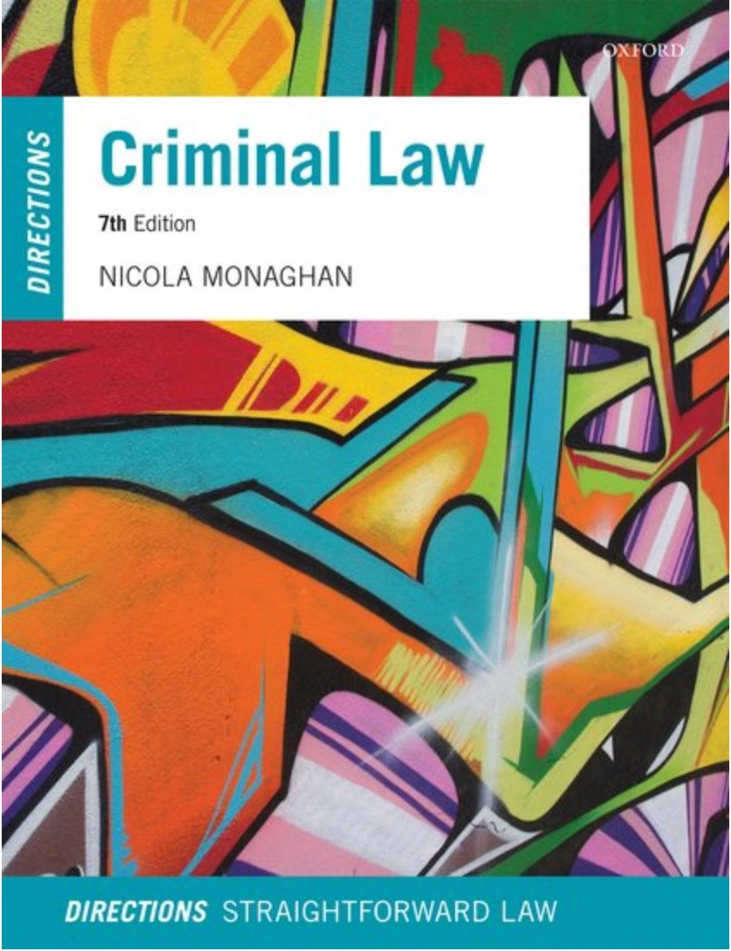
Recommended Books
Monaghan, N. (2022) Criminal Law: Directions, 7th Edition, Oxford: Oxford University Press.

Slide 3

Assessment Format
The course is assessed by an assignment also known as brief for about 3k-5K words by the end of the subject.

Slide 4
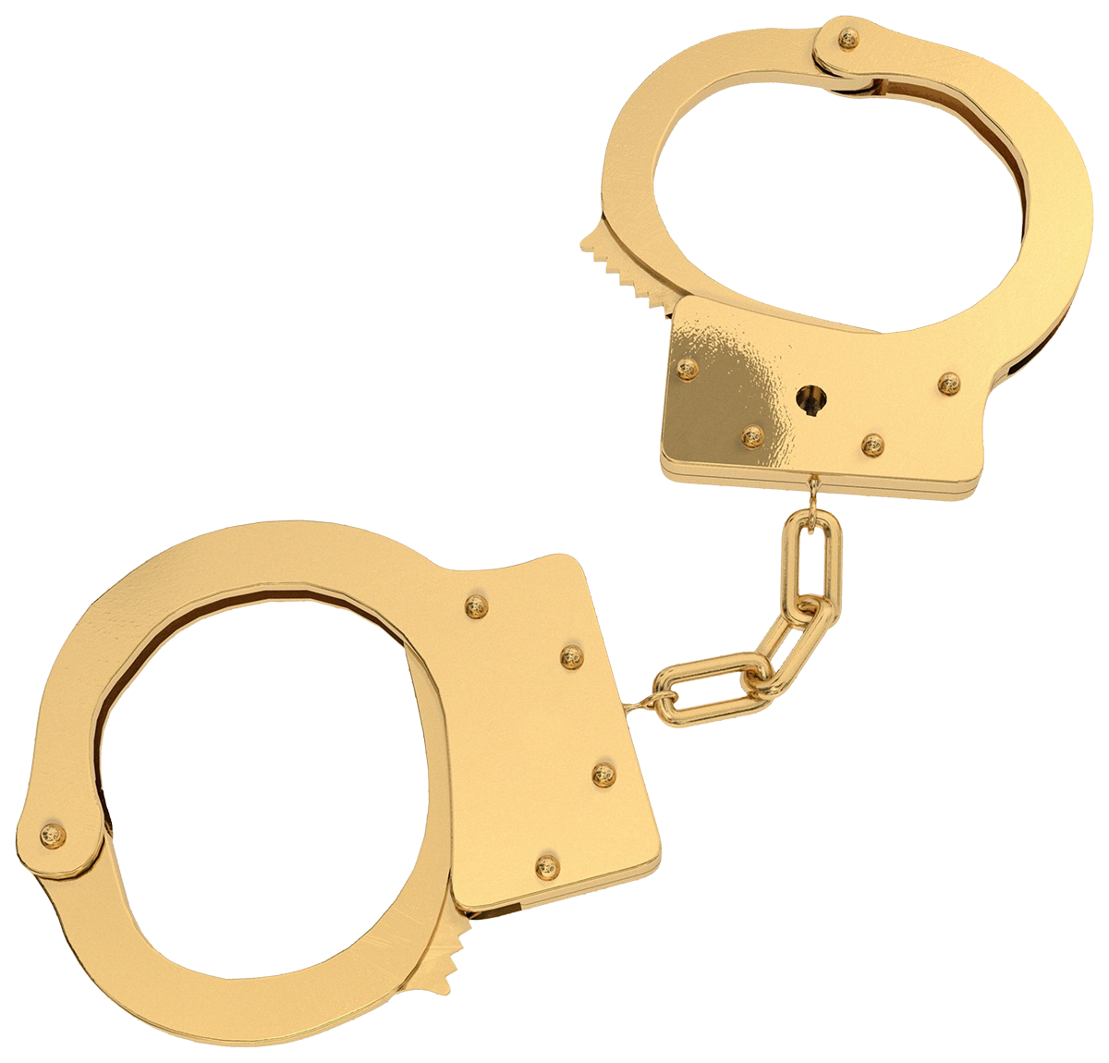
In this part of the lecture we will cover:
The concept of crime
The purpose of the criminal law
The elements of criminal liability
The classification of crimes
An introduction to criminal procedure
An introduction to evidential issues
The importance of the Human Rights Act 1998 and the European Convention on Human Rights 1950
The criminal law in practice

Slide 5
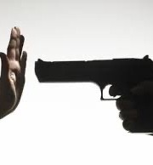
What is a crime?
A public wrong
Affects society at large
Involves harmful conduct
The conduct is prohibited by law
The conduct is punishable by the passing of a sentence by a criminal court
“[T]here is no straightforward moral or social test of whether conduct is criminal. The most reliable test is the formal one: is the conduct prohibited, on pain of conviction and sentence?” (Ashworth, Principles of Criminal Law, 5th ed. at p.4).

Slide 6
What is the purpose of the criminal law?
See the Criminal Procedure Rules Part 1 – ‘the Overriding Objective’ – www.justice.gov.uk
See the Sentencing Act 2020 (‘the Sentencing Code’), s.57 & s.58 – www.legislation.gov.uk
The Libertarian View – to preserve public order and decency
See Mill, J.S. (1859). On Liberty, London: Penguin Books Ltd & the Wolfenden Committee Report (1957) Report of the Committee on Homosexual Offenses & Prostitution, New York: Stein and Day.
The Authoritarian View – to punish those who deserve punishment - presupposes a societal concept of criminality
See Lord Patrick Devlin (1965) The Enforcement of Morals, Oxford: Oxford University Press.
There is no criminal code in the UK.
Conduct may be deemed criminal by statute (an Act of Parliament) or by common law (judge made law).
Are offences created by case law (common law) sufficiently clear to be compatible with the rule of law? See Misra; Srivastava [2004] EWCA Crim 2375 questioning test in R v
Adomako [1995] 1 AC 171

Slide 7
Keeping the criminal law under review
RECENT PREVIOUS
Ministry of Justice Report (2013) ‘Transforming the Criminal Justice System: A Strategy and Action Plan to reform the Criminal Justice System’
Law Commission (1989). A Criminal Code for England and Wales (Law Com. No. 177)
The Halliday Report (2000). Making Punishment Work: Report of a Review of the Sentencing Framework of England and Wales.
Law Commission Report (2014). Simplification of the Criminal Law: Kidnapping and Related Offences.
Govt White Paper (2020), ‘A Smarter Approach to Sentencing’. See also Police, Crime and Sentencing Bill - https://bills.parliament.uk/bills/28 39
The Auld Report (2001). A Review of the Criminal Courts of England and Wales – led to introduction of exceptions to ‘double jeopardy rule’, reform of juries
Govt White Paper (2002) Justice for All – led to Criminal Justice Act 2003

Slide 8
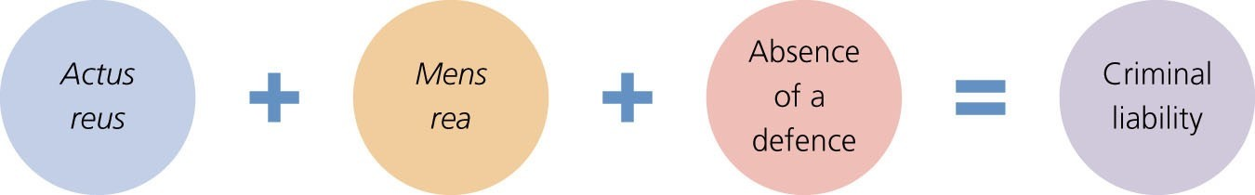
Elements of Criminal Liability
Actus non facit reum nisi mens sit rea – “An act does not make a man guilty of a crime unless his mind is also guilty” (per Lord Hailsham in Haughton v Smith [1975] AC 476).
Actus Reus – a guilty act
Mens rea – a guilty mind
See Law Commission’s proposals in 1989 to rename these elements as 1) External elements (i.e. actus reus) and 2) fault elements (i.e. mens rea)
To obtain a conviction the prosecution must prove:
The defendant brought about the prohibited act/event;
The defendant did so with a prescribed state of mind; AND
The defendant had no defence in law
Figure 1.6 Elements of an offence

Slide 9
An introduction to criminal procedure
All criminal cases start in the Magistrates’ Court and then the more serious cases are transferred to the Crown Court
The case is brought against the defendant by the State who is represented by the prosecution (Crown Prosecution Service)
The defendant has a right to remain silent (on arrest, at the police station and at trial) but doing so will allow the jury to draw an adverse inference at trial
There are 3 types of offences:
Summary (less serious) – triable
only in the Magistrates Court
Either way offences (medium
seriousness) – triable either in the Crown Court or in the
Magistrates Court
Indictable offences (serious) – triable only in the Crown Court
Tribunal of fact – magistrates in the Magistrates Court or jury in the Crown Court

Slide 10
Summary only offences (least serious)
Either way offences
(see S.19 and Schedule 1
Indictable only offences
Magistrates’ Court Act 1980)
Examples
Assault
Assault occasioning ABH (s.47)
Murder
of offences
Battery
Wounding/ inflicting GBH (s.20)
Manslaughter
Driving offences
Theft (including shoplifting)
Rape
Speeding
Driving without
Insurance
Burglary
Robbery
Criminal Damage (including arson)
Wounding/ causing GBH with intent (s.18)
Criminal damage under
£5,000 (excluding arson)
Class A Drugs
Mode of trial
Magistrates Court
Either Magistrates Court or Crown Court
Crown Court
Tribunal of fact
Lay bench of magistrates (or District Judge)
Magistrates or jury (depends upon mode of trial)
Jury

Slide 11
Mode of trial hearing
The mode of trial hearing for either way offences determines whether cases are tried in the Magistrates Court or the Crown Court.
Magistrates accept jurisdiction
D can choose to be tried in the MC or to elect CC trial.
Mode of trial hearing: Representations made by counsel
Plea before venue
Magistrates reject jurisdiction
Case committed to the CC for trial.
Magistrates take into account:
Representations made by counsel
The statutory factors under s.19, MCA 1980 (nature of the case; whether the circumstances of the case make the offence a serious one; whether the sentencing powers of the magistrates would be adequate if the defendant is convicted; any other circumstances)
Sentencing guidelines: www.sentencingcouncil.org.uk

Slide 12
Criminal justice process
Arrest and charge
First court appearance
Investigation
If NG plea - The trial
Verdict
Plea
If G plea or G verdict – sentencing
If NG verdict - acquittal

Slide 13
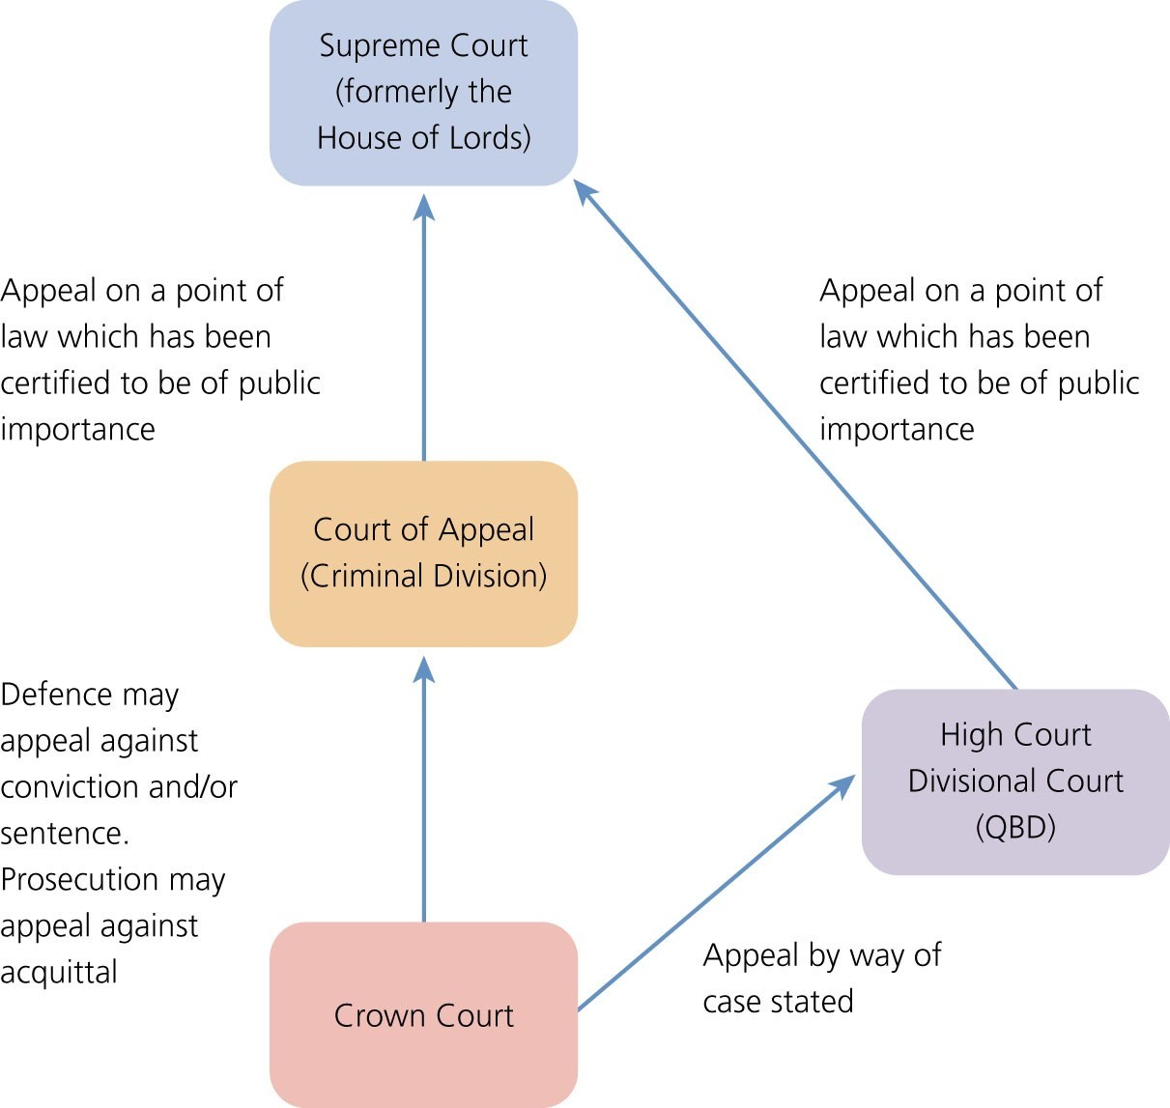
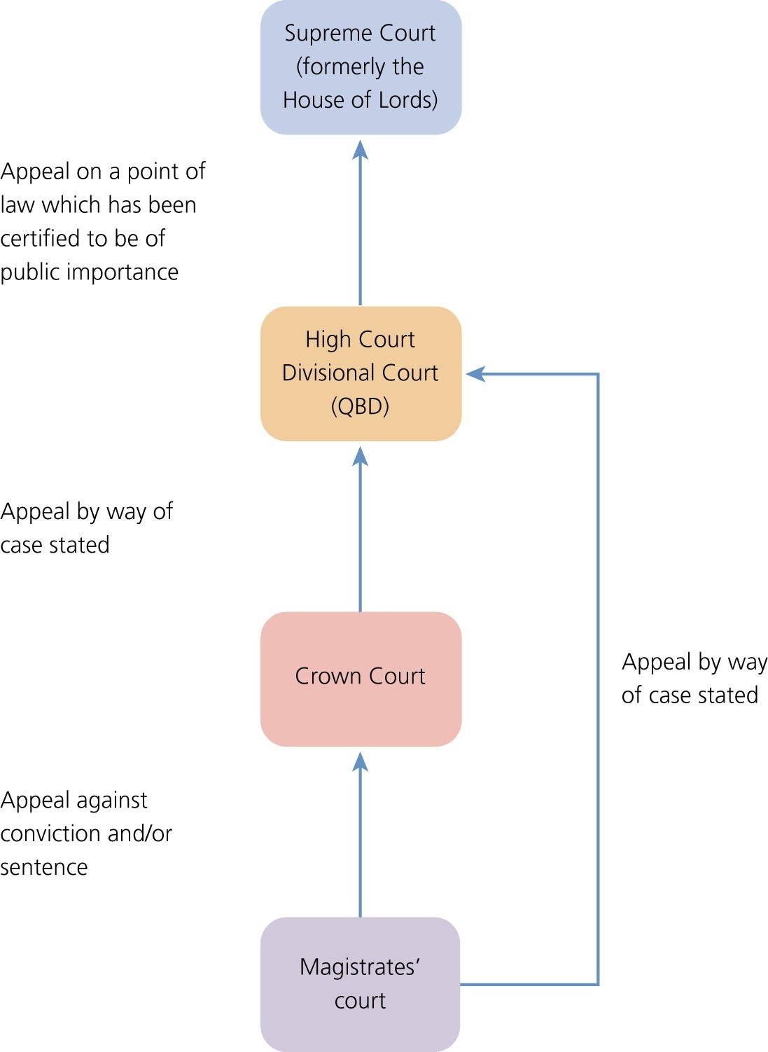
Appeals
Figure 1.4 Appealing from the Crown Court
Figure 1.5 Appealing from the magistrates’ court

Slide 14
An introduction to evidential issues
Burden of Proof
Standard of Proof
Legal burden
= Probative/Persuasive Burden
= Level of probative force needed to win the case or establish a defence.
❑
Legal burden determines which party will lose a trial if that party does not prove its case to the required standard.
The burden which is discharged at the end of the trial when the verdict
is given.
Woolmington v DPP [1935] All ER 1, HL
Rule: the prosecution bears the legal burden of proving every issue, that
is to prove the actus reus and the mens rea of the offence, as well as the lack of a defence (the ‘golden thread’).
Exceptions: sometimes the defendant bears the legal burden of proving an element; e.g. insanity (see McNaghten’s Case [1843] 10 CI & Fin 200,HL; diminished responsibility (see s.2(2) Homicide Act 1957) (‘reverse burden’)
❑
❑
❑
Where the prosecution bears the
legal burden → Beyond
reasonable doubt.
❑
Where the defence bears the legal burden → Balance of probabilities.
Evidential burden → Sufficient evidence to make the matter in question a live issue in the case
→ So a lower standard than
balance of probabilities.
Evidential burden = Burden of Passing the Judge/Adducing Evidence
❑
The burden of adducing sufficient evidence to convince the judge there is an issue to put before the court.
On the prosecution to adduce enough evidence for the issue to go before the jury;
On the defence to adduce enough evidence to make self-defence, loss of control, etc. an issue in the case.
Once the defence has discharged the evidential burden, the prosecution
has the legal burden to disprove self-defence, loss of control, etc.
See R v Galbraith [1981] and A-G’s Reference (No 4 of 2002); Sheldrake
v DPP [2004]
•
•
•
❑

Slide 15

Forms of Criminal Liability
Inchoate Liability – liability for an offence that is incomplete and so a ‘substantive crime’ has not been committed (early stages)
Accessorial Liability – more than one person is involved in the offence, they are known as accessories
Strict Liability – strict liability offences do not require a mens rea element; e.g. public nuisance, s.13 Licensing Act 1872, s.13(1)(c) National Lottery etc Act 1993. See also cases of Prince (1875) LR 2 CCR 154 and Hibbert (1869) LR 1 CCR 184

Slide 16
Influence of the European Convention on
Human Rights
ECHR 1950 was incorporated into UK law by the Human Rights Act 1998 in October 2000
Article 2 – the right to life
Article 3 – “No one shall be subjected to torture or inhuman or degrading treatment or punishment”
Article 4 – the prohibition of slavery and forced labour
Article 6(1) – “Everyone is entitled to a fair trial and public hearing within a reasonable time by an independent and impartial tribunal established by law”
Article 6(2) – “Everyone charged with a criminal offence shall be presumed innocent until proven guilty”.
Article 7 – No punishment without crime and prohibition on retrospective law
Article 5 – The right to liberty and security
Article 8 – Right to respect for family and private life

Slide 17
Law in practice
The nature of the offence The likely sentence
A practitioner will first ascertain whether all elements of the offence have been met.
The likely sentence is determined by statute and by sentencing guidelines. See www.sentencingcouncil.org.uk
However, a defendant can get a ‘discount’ for an early plea of guilty.
The defence practitioner will be responsible for arguing for a reduction in sentence known as ‘a plea in mitigation’.
The court can also take into account the impact the crime has had on others (through a ‘victim personal statement’).
This can be done by referring directly to legislation or the common law (cases).
E.g. Blackstones Criminal Statutes or www.legislation.gov.uk
The next stage is to establish whether a defence is available to the defendant.
The practitioner will then collect evidence to either support or defend the charge.

Slide 18
Part 3 – Interactive Activities

Slide 19
Elements of a criminal offence: Task 1
Identify the actus reus and mens rea elements in the following offence:
Theft is defined under s.1(1), Theft Act 1968 as where the defendant “dishonestly appropriates property belonging to another with the intention of permanently depriving the other of it...”

Slide 20
Elements of a criminal offence: Task 1
Actus reus of theft
Appropriation
Property
Belonging to another
Mens rea of theft
Dishonestly
Intention to permanently deprive

Slide 21
Elements of a criminal offence: Task 2
Identify the actus reus and mens rea elements in the following offence:
Murder is defined under common law as unlawfully causing the death of a reasonable creature in being with the intention to kill or cause grievous bodily harm.

Slide 22
Elements of a criminal offence: Task 2
Actus reus of murder
Unlawfully
Mens rea of murder
Causing
Intention to kill or cause GBH
Death
Of a reasonable creature in being

Slide 23
MCQs
Matthew is charged with robbery and wants to plead not guilty. He asks you where his trial will take place. Which is the correct answer?
Robbery is an either way offence so Matthew may be tried in the Magistrates Court or the Crown Court;
Robbery is an indictable only offence so Matthew will be tried in the Magistrates Court;
Robbery is an indictable only offence so Matthew will be tried in the Crown Court;
Robbery is an indictable offence so Matthew may be tried in the Crown Court.

Slide 24
MCQs
2) Fatima is charged with assault occasioning actual bodily harm under s.47, Offences Against the Person Act 1861. She decides to plead not guilty. She asks you where her trial will take place. Which is the correct answer?
This is an either way offence which may be tried in either the Crown Court or the Magistrates Court;
This is an indictable only offence which must be tried in the Crown Court;
This is a summary only offence which must be tried in the Magistrates Court;
This is an either way offence and must be tried in the Magistrates Court and if she is found guilty, sentencing will take place in the Crown Court.

Slide 25
MCQs
3) Peter is convicted of theft in the Magistrates Court. He wishes to appeal against his sentence. In which court will his appeal be heard?
The Court of Appeal;
The Crown Court;
The Divisional Court;
The Supreme Court.

Slide 26
MCQs
4) Rahul is acquitted after a successful submission of no case to answer by his defence counsel during his trial for rape in the
Crown Court. The prosecution wish to appeal against his
acquittal. Which of the following statements is true?
The prosecution may not appeal against an acquittal;
The prosecution may appeal to the Supreme Court;
The prosecution may appeal to the Divisional Court;
The prosecution may appeal to the Court of Appeal.

Slide 27
MCQs
5) Gerald is charged with battery and wishes to plead self-defence. Which of the following statements is true?
The evidential burden and the legal burden of proving the offence and disproving self-defence are on the prosecution;
The legal burden of proving the offence is on the prosecution but Gerald bears the evidential burden in respect of self-defence;
The legal burden of proving the offence is on the prosecution but Gerald bears the legal burden of proving self-defence;
The legal burden of disproving the offence and proving self-defence is on the Gerald.

Slide 28
MCQs
6) Rita is charged with murder and pleads diminished responsibility. Where does the burden lie in respect of the defence and what is the relevant standard of proof?
a. The prosecution bears the burden of disproving diminished responsibility beyond reasonable doubt;
b. The prosecution bears the burden of disproving diminished
responsibility on a balance of probabilities;
c. Rita bears the burden of proving diminished responsibility beyond reasonable doubt;
d. Rita bears the burden of proving diminished responsibility on a balance of probabilities.

Slide 29
MCQs
7) Which ONE of the following statements is FALSE?
A defendant charged with an either way offence will not have a right to elect trial by jury if the magistrates accept jurisdiction of the case;
A defendant charged with a summary only offence does not have a right to trial by jury;
A defendant charged with an indictable only offence must always be tried by a jury;
A defendant charged with an either way offence will not have a right to refuse trial by jury if the magistrates commit the case to the Crown Court.

Slide 30
MCQs
8) Which ONE of the following statements is FALSE?
In a Crown Court, the judge is the tribunal of law;
In a Crown Court, the jury is the tribunal of fact only;
In a Magistrates Court, the magistrate(s) is/are the tribunal of fact only;
In a Magistrates Court, the magistrate(s) is/are both the tribunal of fact and law.

