Slide 1
Lecture 2 – Actus Reus

Slide 2
What we have learnt so far…
How to define and identify a crime
The purpose of criminal law (libertarian v authoritarian approaches)
The elements of criminal liability (actus reus + mens rea + no defence)
The classification of crimes (summary, either-way and indictable offences)
An introduction to criminal procedure
An introduction to evidential issues
The importance of the Human Rights Act 1998 and the European Convention on Human Rights 1950

Slide 3

What will we cover in this session?
How the actus reus concept impacts on criminal liability
When omissions can lead to criminal liability
The requirement for causation as part of the actus reus in result crimes
An introduction to the IRAC method for answering problem questions

Slide 4
The Building Blocks of Criminal Liability
Actus Reus (lecture 2) | Mens Rea (lecture 3) | No Defence (Term 2)
THE EXTERNAL | THE MENTAL | LEGALLY ACCEPTED
ELEMENT: | ELEMENT: | JUSTIFICATION /
 |  | EXCUSE:
THE ACT or THE | E.g.
OMISSION (Rarely) | INTENTION KNOWLEDGE RECKLESSNESS ‘GROSS | E.g. SELF-DEFENCE, AUTOMATISM, INSANITY,
 | NEGLIGENCE’ DISHONESTY | DURESS LOSS OF SELF
 |  | CONTROL
 |  | DIMINISHED
 |  | RESPONSIBILITY CONSENT

Slide 5

The Actus Reus of a criminal offence
It is a fundamental principle of English criminal law that a person may not be convicted of a crime unless they have behaved in an unlawful way.
A defendant cannot be convicted of a criminal offence based on their thoughts alone, there must also be a criminal act/failure to act.
Every criminal offence has its own Actus Reus. If the Actus Reus has not been performed, then the offence will not have been committed.
In criminal trials the burden of proof will be on the prosecution to prove “beyond reasonable doubt” that the defendant performed the Actus Reus. If this cannot be done, the defendant will not be criminally liable for the offence with which they have been charged.

Slide 6
Three types of Actus Reus element
Conduct (where D performs a positive act or omission – see OMISSIONS
below)
Consequences (where D causes a result – see CAUSATION below)
Circumstances (where certain surrounding circumstances exist which lead to liability)
Any one or more of these may be required for any given criminal offence.
E.g. theft
(conduct + circumstances), murder (circumstances + conduct +
consequences)

Slide 7
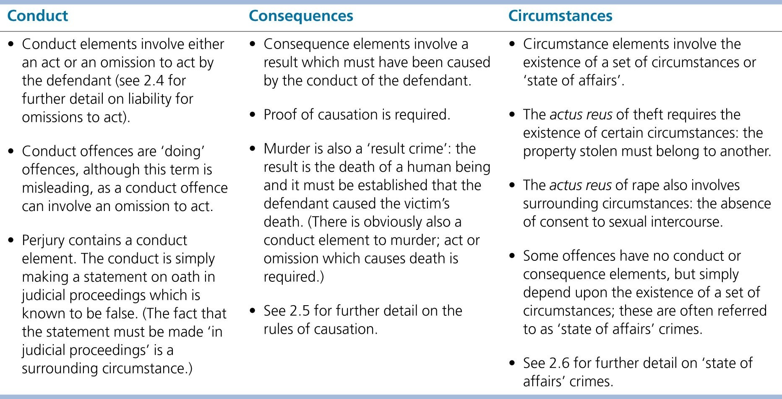
© O
x
f o r d U
n i v e r s i t y P
r e s s
, 2
0
2
0
Table 2.1 Conduct, consequences, circumstances

Slide 8
Requirement of Voluntariness
There is a general rule that the actus reus elements of an offence must be voluntary in order for criminal liability to be imposed. Where the actus reus is involuntarily performed, there is no criminal liability.
“A person… who, through no fault of his own, becomes unconscious while driving, for example, by being struck by a stone, or by being taken ill, ought not to be liable at criminal law” (obiter dicta per Humphreys J in Kay v Butterworth [1945] 173 LT 191).
“[I]n Kay v. Butterworth... the judge, after emphasizing that drowsiness or sleep would be no excuse, said that ‘he did not mean to say that a person should be made liable at criminal law who through no fault of his own became unconscious while driving; for example, if he were struck by a stone or overcome by a sudden illness; or the car was temporarily out of control by his being attacked by a swarm of bees’” (per Lord Goddard CJ in Hill v Baxter [1958] 1 QB 277).
“…there may be cases where the circumstances are such that the accused could not really be said to be driving at all. Suppose he had a stroke or an epileptic fit, both instances of what may properly be called acts of God; he might well be in the driver's seat even with his hands on the wheel, but in such a state of unconsciousness that he could not be said to be driving.”
“A blow from a stone or an attack by a swarm of bees I think introduces some conception akin to novus actus interveniens”. (per Lord Goddard CJ in Hill v Baxter [1958] 1 QB 277).
We will cover the defence of automatism in the second term.

Slide 9
Circumstances – “State of Affairs” crimes
As Michael J. Allen explained in his Textbook on Criminal Law (2009:22): “[W]hile most offences require voluntary conduct on the part of the accused to establish their actus reus, there are some offences which prohibit the existence of a state of affairs.” Indeed, sometimes people can find themselves in a prohibited situation without having put themselves in that state. No mens rea is required for conviction. These offences are quite rare.
Offences of absolute liability are “state of affairs” crime because they are entirely dependent upon the existence of surrounding circumstances but require no conduct from the D.
Winzar v Chief Constable of Kent [1983], The Times, 28 March – being drunk on a highway (s.12, Licensing Act 1872)
Larsonneur [1933] 97 JP 206 – being illegally in the UK (Aliens Order 1920)

Slide 10

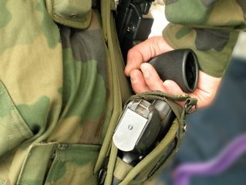

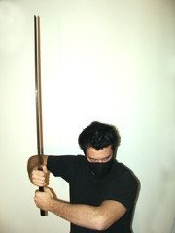
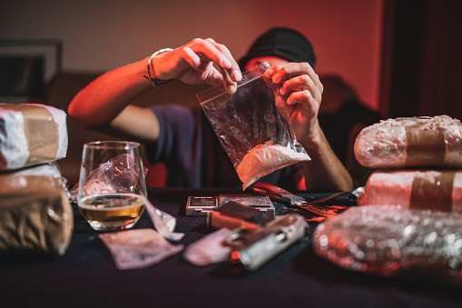

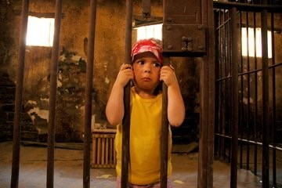
Acts and Omissions?

Slide 11
The Actus Reus of a criminal offence –
General Rule
The general rule in English law is that criminal liability cannot arise from an individual’s failure to act.
In other words, the actus reus of an offence can only be performed by way of a voluntary positive action, rather than an omission (i.e. it requires an actual “act”).
“[N]ormally, the actus reus doctrine requires an action of some sort: something done by the defendant” – Simester, A. et al. (2010) Simester & Sullivan’s Criminal Law: Theory and Doctrine, Oxford: Hart Publishing, pg.64.
“A sees B drowning and is able to save him by holding out his hand. A abstains from doing so in order that B may be drowned, and B is drowned. A has committed no offence” – Stephen, Digest of Criminal Law, 1887.
“ There is no duty of easy rescue ” (i.e., there is no criminal liability for an omission/failure to act).
Contrast approach in other European countries, e.g., in France and Germany.

Slide 12




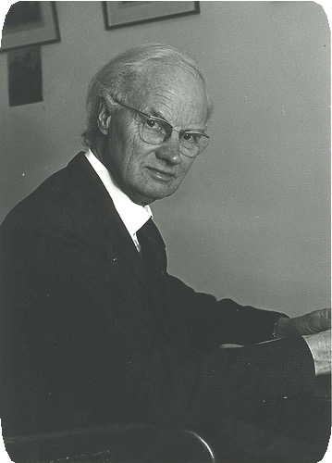
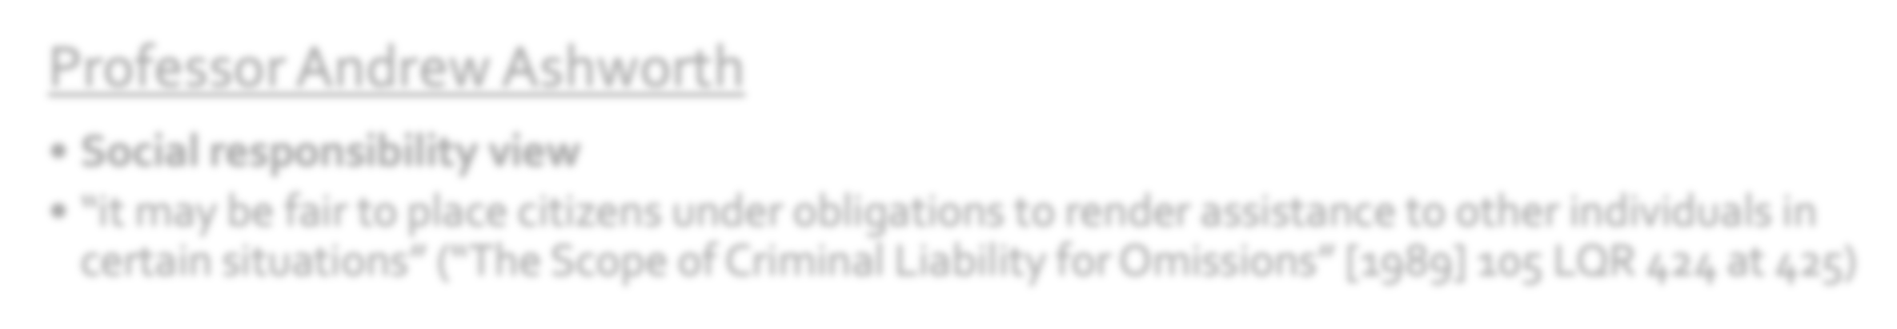



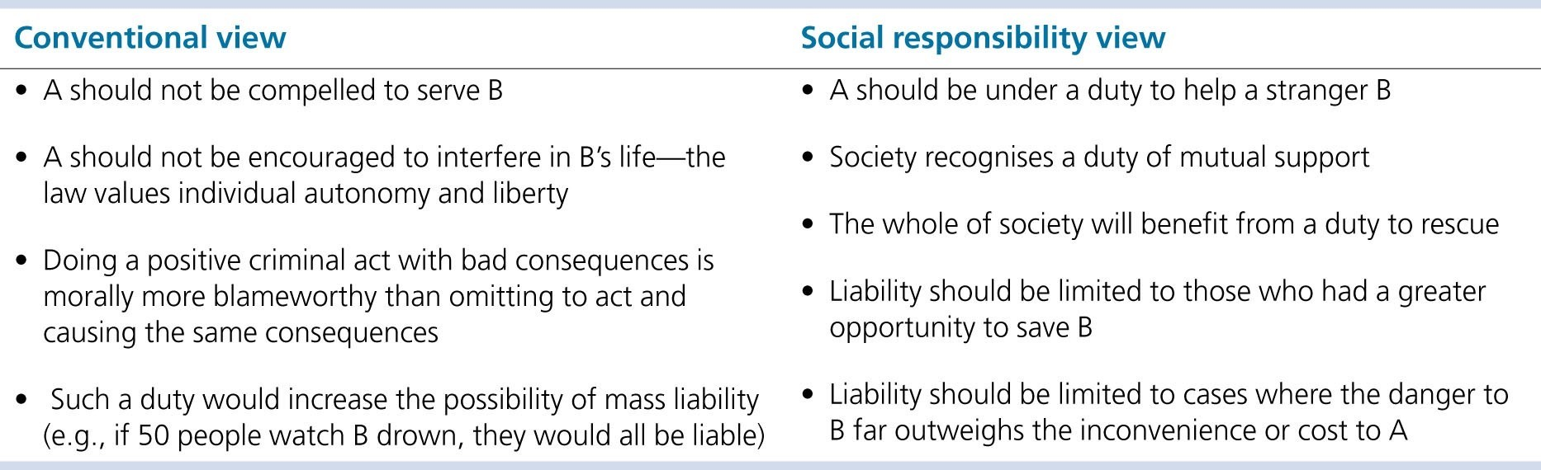
There are 2 schools of thought on whether
there should be a general duty to rescue:
Professor Glanville Williams
Conventional view
“omissions liability should be exceptional , and needs to be adequately justified in each instance” (“Criminal Omissions – The Conventional View” [1991] 106 LQR 86 at 87)
Professor Andrew Ashworth
Social responsibility view
“it may be fair to place citizens under obligations to render assistance to other individuals in certain situations” (“The Scope of Criminal Liability for Omissions” [1989] 105 LQR 424 at 425)
Table 2.2 Conventional view vs social responsibility view

Slide 13
The Actus Reus of a criminal offence -
Exceptions
However, there are some exceptions to the general rule…
Under common law and statute, certain categories of people are placed under a positive duty to act, whereby a failure to act may give rise to criminal liability.
These situations are:
  Where there is a special relationship between the defendant and the victim;
  Where the defendant voluntarily assumes responsibility for the victim;
  Where the defendant is under a contractual duty to act a certain way;
  Where public office creates a duty for the defendant to act a certain way;
  Where the defendant creates a dangerous situation he has a duty to avert any emergent dangers ; and
  Where statute imposes a duty to act on the defendant

Slide 14
Special Relationships
If a special relationship exists between a defendant and victim, the defendant will be under a positive duty to act in a certain way.
If they fail to do so, this may give rise to criminal liability.
Downes [1875]
Gibbins and Proctor [1918]
Hood [2004]

Slide 15
Voluntary assumption of responsibility
Where a defendant has voluntarily assumed responsibility for the victim (e.g. by caring for them) a positive duty to act may be imposed on the defendant.
If the defendant fails to act in accordance with this duty, their failure to act may give rise to criminal liability.
Stone and Dobinson [1977]
Airedale NHS Trust v Bland [1993]
Ruffell [2003]

Slide 16
Contractual Duty
Contractual duties (e.g. a duty imposed on a defendant by way of a contract of employment) can also create a positive duty to act a certain way.
Failing to perform a contractual duty may in some instances give rise to criminal liability.
Pittwood [1902]

Slide 17
Public Office
Closely linked to contractual duties are duties that may arise from the defendant holding public office (a position of authority which entails responsibility to the public, usually in a governmental capacity).
Occasionally, the holding of such a position may create a positive duty to act a certain way (e.g., a police officer).
Dytham [1979]

Slide 18
Creation of a dangerous situation
Under the common law a defendant who creates a “dangerous situation” has a duty to prevent a prohibited result from occurring as a consequence of that situation.
In other words, a defendant who creates a dangerous situation may be criminally liable for any harm and/or damage that occurs as a result of that situation occurring.
Miller [1983]

Slide 19
Statutory Duties
Sometimes statutes can impose a positive duty to act in a certain way on defendants.
If the defendant fails to act in the way specified by the statute this will be a criminal offence.
See, for example, Sections 6 and 170 of the Road Traffic Act 1988 and Section 19 Terrorism Act 2000.
https://www.legislation.gov.uk/

Slide 20











Omissions Diagram
See R v Ahmad [1986] 84 Cr App R 64
D may be liable if there is:
a contractual duty to act or
a statutory duty to act or
a public office duty to act
D may be liable under a relationship duty
Yes
D may be liable if there is
an implied duty to act or
the creation by D of a dangerous situation
Is D under a duty to act and is the offence capable of being committed by omission?
No
D cannot be liable for failure to act

Slide 21
Causation
Many offences in English criminal law are often referred to as so-called “result crimes”.
These are crimes which require the defendant’s actions or behaviour to culminate in a particular unlawful “result” in order for them to be committed.
For instance, murder is a result crime. The unlawful “result” is the death of the victim. Without this result, there can be no murder, as the victim would still be alive.
In such cases the prosecution must prove the defendant “caused” the unlawful result.
Causation is best understood as a three-stage process - a defendant can only be convicted of a result crime if the prosecution can establish the following:
  That the defendant’s actions were the factual cause of the unlawful result;
  That the defendant’s actions were the legal cause of the unlawful result; and
  That there was no intervening act (novus actus interveniens) which breaks the “chain of causation”.

Slide 22



Factual Causation – “Causation in fact”
The defendant’s actions must be the “factual cause” of the unlawful result.
Factual causation is determined by the use of the “but for” test. In other words, it must be established that the unlawful result would not have occurred as and when it did “but for” the actions of the defendant.
See the case of White [1910] for an example of the defendant escaping criminal liability due to the prosecution not being able to prove that he was a factual cause of the victim’s death.

Slide 23



Legal Causation – “Causation in law”
The defendant’s actions must also be the “legal cause” of the unlawful result.
What this essentially means is that the defendant’s actions do not need to be the only cause of the unlawful result, so long as they are a significant, operative, or proximate cause. See Pagett [1983] and Broughton [2020].
In other words, the prosecution must show that the defendant’s behaviour was more than a minimal (or trivial) cause of the unlawful result. See: Pagett [1983] and Kimsey [1996]

Slide 24
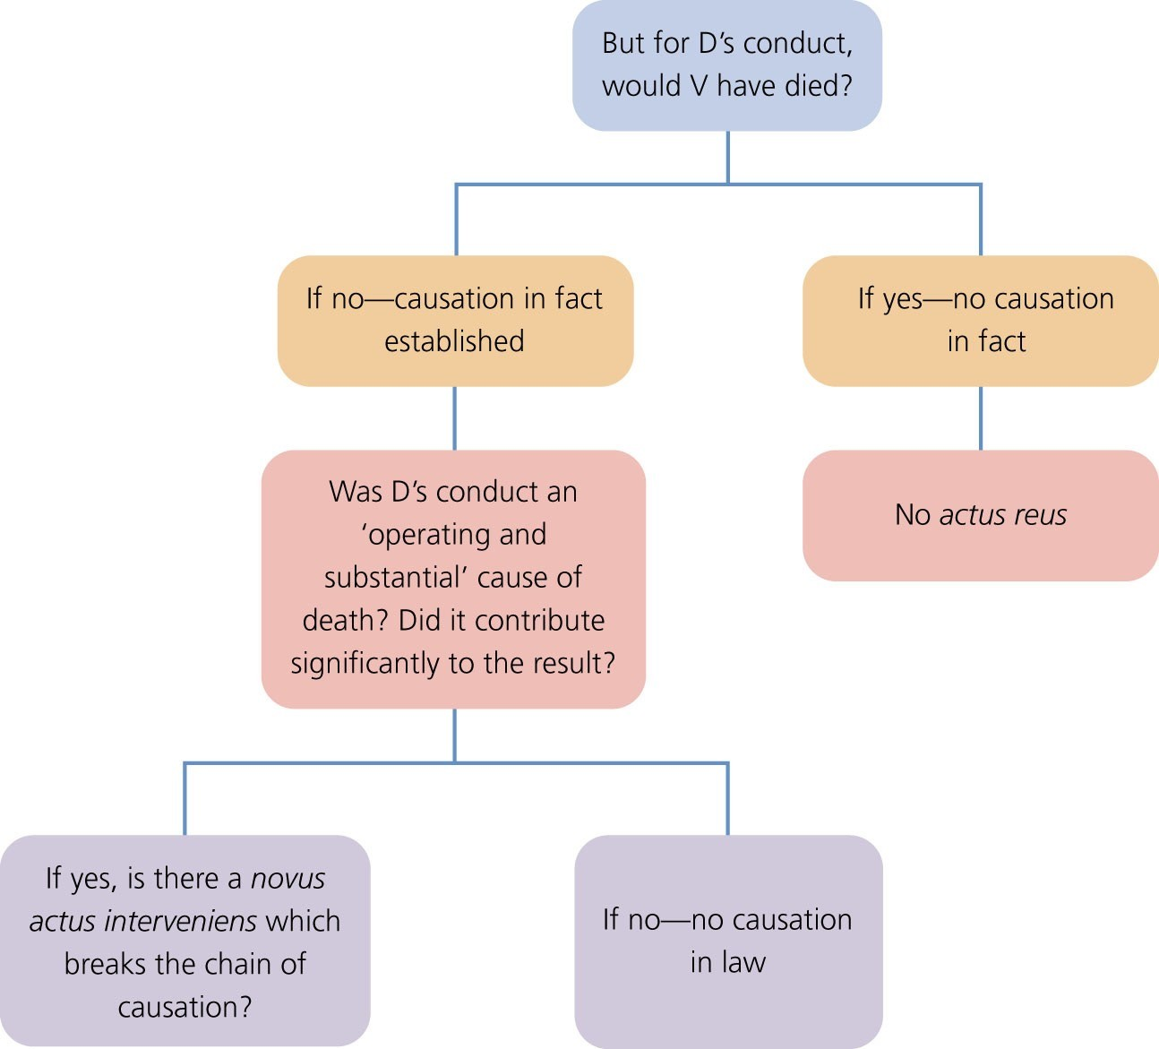
© O
x
f o r d U
n i v e r s i t y P
r e s s
, 2
0
2
0
Figure 2.4 Causation flowchart for a fatal offence

Slide 25
Breaks in the “chain of causation”
The presence of both factual and
legal causation
of causation”
constructs the metaphorical “chain
between the defendant’s actions and the unlawful result they are accused of being criminally liable for.
However, if there is an intervening act (often referred to as a “novus actus interveniens”) the chain of causation will be considered broken (i.e. causation will not be established).
There are several ways in which the chain of causation for a defendant’s actions may be broken.

Slide 26
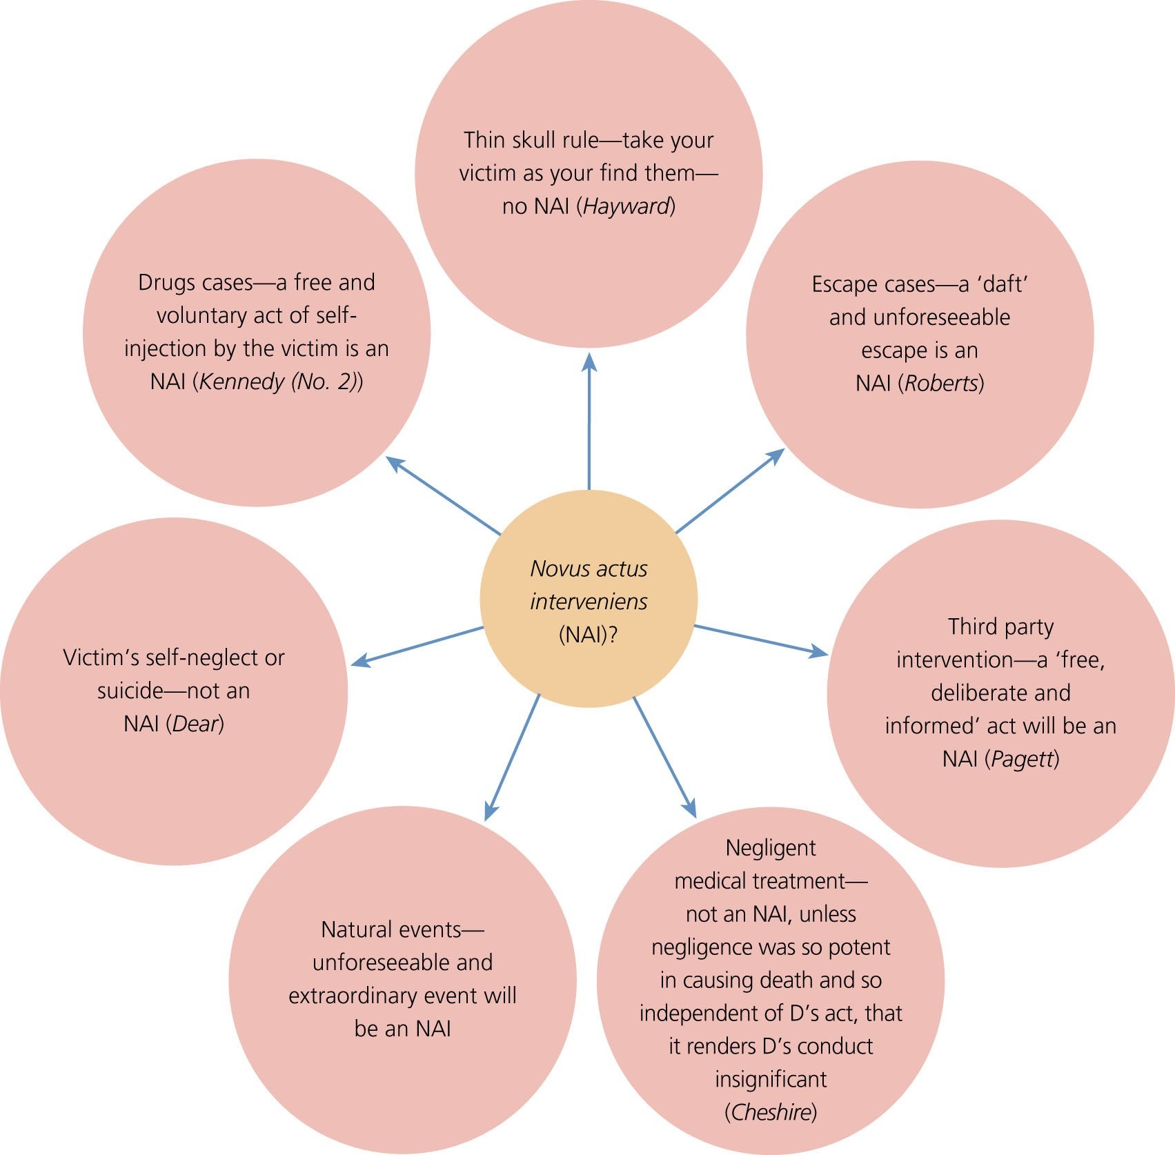
Figure 2.6 What amounts to an intervening act?

Slide 27
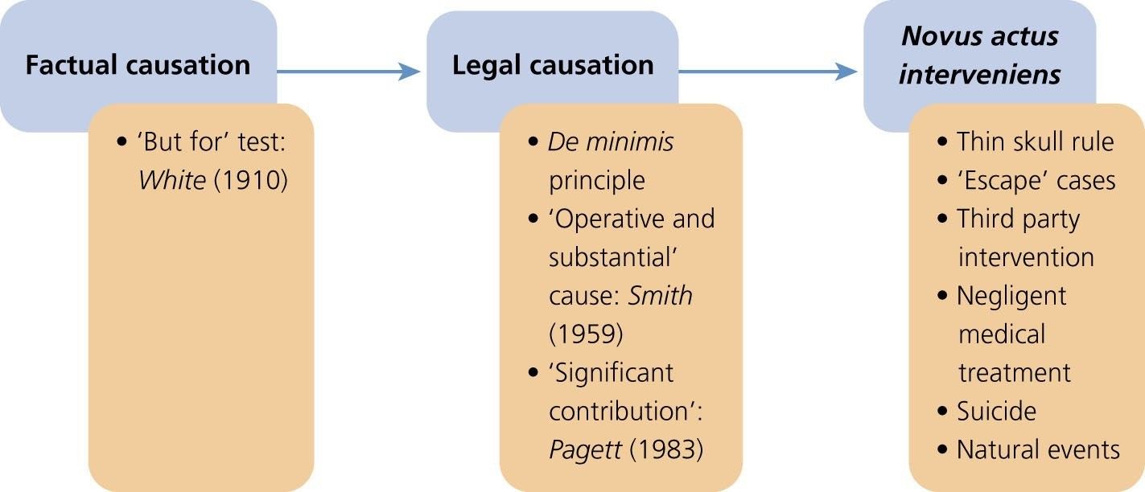
Figure 2.2 Causation

Slide 28

Causation Flowchart
Factual Causation
Legal Causation
Novus Actus Interveniens
Possible Liability of Third Party
No Liability on Defendant

Slide 29
Answering a Problem Question
Are the building blocks for criminal liability (actus reus + mens rea+ no defence) present? Discuss each.
If so, are there any additional building blocks to consider, e.g. omissions, causation?
If all the building blocks are not present, which are missing and what impact will this have?
Always ensure that you support your answer with authorities (e.g. cases, legislation, journal articles)

Slide 30
The IRAC Method (Problem Questions)
IRAC = Issue + Rule + Application + Conclusion
Issue – name the legal issue raised by the facts in the problem question e.g. is there any criminal liability for D’s action? Does D have a defence? Is there third party liability?
Rule – Go through each relevant fact and identify the legal requirements that must be met – e.g. can D’s actions be viewed as an act or an omission? Does D have the relevant intention or do other factors apply, such as recklessness/negligence?
Application – use the facts to help you identify relevant case law or statute for each element to support your arguments. Do not waste time repeating the facts of cases – stick to the legal principle.
Conclusion – draw all your arguments together and reach a view on liability.

Slide 31

Part 2 – Interactive Activities

Slide 32
Problem Question
Alan, Bernard and Charles are three brothers. One night, Alan and Charles go out drinking to a local pub. Towards the end of the evening, they have a serious argument. Alan grabs a glass bottle, smashes it against the bar and slashes it across Charles’ neck, causing severe bleeding. Charles is rushed to hospital, but it is New Year’s Eve, the A&E is at breaking point, and Charles is left on a trolley for several hours before he is seen. He is finally examined by a newly qualified doctor, who has been on shift for twelve hours and is still recovering from a hangover from the night before. The doctor does not check Charles’ medical notes properly and administers a drug to which Charles is known to be allergic. Several hours after this, Charles dies. When Charles’ mother hears, she is so distraught that she kills herself. Bernard determines to kill Alan to avenge the death of his mother and brother. Bernard arranges to meet Alan in a local pub and slips poison into his drink. However, before the poison has any time to work, Alan leaves the pub and is run over and killed outright by a lorry.
Identify the actus reus and discuss the role of causation in determining the guilt of the parties involved in the above offences by reference to relevant case law.

Slide 33
Framework for a suggested answer
Issue | Rule | Application
What is the offence? | Murder – R v Maloney | Alan causing wounding but not death due to death being unrelated to act Hospital – Gross negligence manslaughter due to not reading patient’s notes properly Bernard - attempted murder due to poison not being cause of death Bernard’s mother – suicide is not a crime and no causation in relation to her death
What is the actus reus? | Attempted Murder – R v White
What is the mens rea?
Is it a result crime? | Factual Causation – ‘But For’ test
Can causation be established? | Legal Causation – Operative and Substantial Cause – R v Pagett
 | Novus Actus Interveniens – R v Cheshire

Slide 34
Answer: Key Points
What is the offence? Offence is murder or manslaughter?
What is the mens rea? – intention to kill or cause GBH
Is it a result crime? – causation is important
What is the Actus Reus? – slashing Charles neck (an act)
Causation – factual (but for) and legal causation (substantial, operative, blameworthy)
Is there a Novus Actus Interveniens? - Charles dies from allergy to antibiotics – intervening act of hospital - to break chain of causation Cheshire test is applied – independent, potent and renders D’s act insignificant
Alan is not responsible for his mother’s death – no offence that covers this
Bernard’s liability – attempted murder

Slide 35
MCQs
Peggy fails to feed her 3 year old daughter, Lisa. Lisa dies due to starvation. Under which of the following categories of duty is liability most likely to be imposed upon Peggy for her failure to act?
  Contractual duty and statutory duty;
  Public duty and special relationship;
  Duty to avert danger created and contractual duty;
  Special relationship and statutory duty.

Slide 36
MCQs
2) Richard moves in with his elderly aunt to look after her when she falls ill. She provides him with money to do the weekly shopping. However, Richard spends the money on a new TV and fails to call for medical assistance when his elderly aunt falls ill. As a result, she dies. Under which of the following categories might the law impose a duty on Richard to act?
Voluntary assumption of responsibility;
Special relationship;
Statutory duty;
Contractual duty.

Slide 37
MCQs
3) Samantha is stopped by a police officer who wishes to carry out a lawful search of her. The police officer asks Samantha if she is carrying any needles. Samantha states that she is not. The police officer searches Samantha and is stabbed by a hypodermic needle. Under which of the following categories of duty is liability most likely to be imposed upon Samantha for her failure to act?
Special relationship;
Duty to avert danger created;
Voluntary assumption of responsibility;
Public duty.

Slide 38
MCQs
4) Mohammed, a zoo keeper in charge of the lions’ den, leaves the door to the lions’ den unlocked after feeding time. A lion escapes and attacks a visitor to the zoo. Under which of the following categories of duty is liability most likely to be imposed upon Mohammed for his failure to act?
Special relationship;
Voluntary assumption of responsibility;
Statutory duty;
Contractual duty.

Slide 39
MCQs
5) Which of the following cases is authority for the principle that a “free, deliberate and informed” act of a third party will break the chain of causation?
Cheshire (1991);
White (1910);
Pagett (1963);
Roberts (1971).

Slide 40
MCQs
6) Which of the following cases is an authority on the “thin skull rule”?
Smith (1959);
Blaue (1975);
Kennedy (No. 2) (2007);
Jordan (1956).

Slide 41
MCQs
7) Bill is attacked by Kevin during a fight. Bill sustains a stab wound to the chest and is taken to hospital where a doctor misdiagnoses the severity of Bill’s injuries and fails to treat him properly. Kevin is charged with inflicting GBH. Which of the following authorities is NOT likely to be applied in respect of whether the doctor’s negligent treatment will break the chain of causation?
Jordan (1956);
Smith (1959);
Malcherek and Steel (1981);
Cheshire (1991).

Slide 42
MCQs
8) Which of the following will always break the chain of causation?
Negligent medical treatment;
A reasonably foreseeable escape;
A free and informed act by the victim;
An unforeseeable physical condition of the victim.

