Slide 1
Lecture 3 – Mens Rea and Strict Liability

Slide 2

What will we cover in this session?
How the Mens Rea concept impacts on criminal liability
Introduce 3 examples
  Intention
  Recklessness
  ‘Gross negligence’
Consider the tests that have developed in case law for intention and recklessness
Examine the principle of ‘transferred malice/mens rea’

Slide 3















The Anatomy of a Crime
ACTUS REUS
MENS REA
NO DEFENCE
CRIME

Slide 4
Exception to Mens Rea Requirement = Strict
Liability
In the case of strict liability offences there is no requirement to prove that the defendant had a ‘guilty mind’ in order to find guilt –the act alone is enough
Strict liability offences include:
  Traffic Offences (speeding, driving without insurance)
  Food Hygiene
  Health and Safety
  ‘State of Affairs’ offences – see R v Larsonneur [1933] 24 Cr App R 74

Slide 5
Mens Rea – Definition and Terminology
The mens rea of a criminal offence is traditionally said to be the “guilty mind”. However, this is somewhat misleading, as it is sometimes confused with the idea of a bad motive.
A better way of understanding mens rea is as “the mental element required by the crime” – an act does not make a person guilty without a guilty mind.
In other words, “mens rea” refers to the mental state of the defendant at the time they are performing the actus reus of a criminal offence.
It is necessary to refer to statute or case law to find the relevant mens rea for the offence.

Slide 6
Examples of Mens Rea
There are many forms of mens rea in criminal law, including:
  Intention (requirement for e.g. murder)
  Recklessness (requirement for e.g. criminal damage)
  Negligence (rarely enough unless gross negligence e.g. Gross Negligence Manslaughter)
  Dishonesty (requirement for theft)
  Knowledge (requirement in some drug offences)
The most common types of mens rea, and the most relevant to the offences you will study as a part of this module are intention and recklessness.

Slide 7


















Diagram showing mental states of mind
included in mens rea
Direct Intention
(e.g. Murder, ABH, GBH, Wounding)
Oblique/Indirect Intention
(e.g. Murder, Criminal Damage, ABH, GBH, Wounding)
Subjective Recklessness
(e.g. Criminal Damage, ABH, GBH, Wounding)
Gross Negligence
(e.g. Involuntary Manslaughter)
Dishonesty
(e.g. Theft, Robbery, Fraud)

Slide 8
Intention
Many criminally offences (e.g. murder, theft, rape) can only be committed if the defendant performs the actus reus of the offence “intentionally”.
For instance, the mens rea for the offence of murder is an intention to kill or cause grievous bodily harm. See: Vickers [1957]
It is important at this point to note that “intention” and “motive” are not the same thing.
However, “intention” is a word not defined anywhere in legislation, and has caused some confusion for the law.

Slide 9
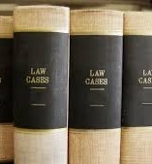
Intention explained through case law
Two types of intention are now recognised:
Direct Intent
Indirect or ‘Oblique’ Intent

Slide 10
Direct Intent
Working out whether a defendant has directly intended to do something is usually not difficult.
It is now widely accepted that a person who acts with the purpose of causing a specific result will be taken to have intended to cause that result. See Hayes v Willoughby [2013] UKSC 17.
For instance, if D fights an opponent and tries his best to seriously injure that person then he clearly intends to inflict serious injury. He may still intend serious injury if he realises that his chances of success are less than 100%. For example, if he appreciates that his opponent is a much more skilled fighter than himself but he nevertheless keeps on trying to knock the opponent unconscious, he still intends to seriously injure the victim.
If, for example, A deliberately gives a lethal injection to B in order to kill B and end their suffering, A clearly intends to kill B. However, this is not the same as desire, as A may wish that they did not have to give B a lethal injection, but went ahead and did so anyway.

Slide 11
Oblique Intent
Whilst direct intention should cover most situations regarding issues relating to intention, problems arise when a defendant’s aim, purpose, goal or desire is not prohibited by the law, but the defendant realises that in order to achieve their primary purpose they will have to act in a way that is prohibited.
For example, A insures a package against fire damage. The package is scheduled to travel on a transatlantic flight the next day. He conceals a bomb in the package which is timed to explode mid-flight. He does this so that he can claim on his insurance policy. He does not intend to kill any of the passengers on the flight, but recognises that at least some will surely die if his plan is carried out.

Slide 12
Oblique Intent
Clearly there is no direct intention to kill the passengers.
If, therefore, the only type of intention the law limited itself to was “direct” intention, then A would not be liable for the murder of any of the passengers killed by the exploding package.
This would surely not be a sensible or reasonable approach.
It is for this reason that the meaning of the word “intention” has been extended by judges to encompass behaviours similar to the fictional scenario involving A and the plane.
This extension has resulted in the courts developing a second type of recognised intention, oblique intention.
However, the precise limits and meaning of this term has caused the courts many problems.

Slide 13
Oblique Intent
The leading test for oblique intention can be found in Woolin [1999]: “The consequences must be virtually certain to occur and the defendant must appreciate this.”
So, in other words, if a defendant is “virtually certain” that their behaviour/actions will cause a certain result, and they are aware of this fact, they can be taken to have obliquely intended that result, even if they did not directly intend it.
If, therefore, we are to apply this test to the fictional scenario involving A and the plane, it seems likely that A would be taken to have obliquely intended to cause the deaths of the plane’s passengers.
However, the law has not always been as straightforward, and it is useful to consider how it has developed over time.

Slide 14
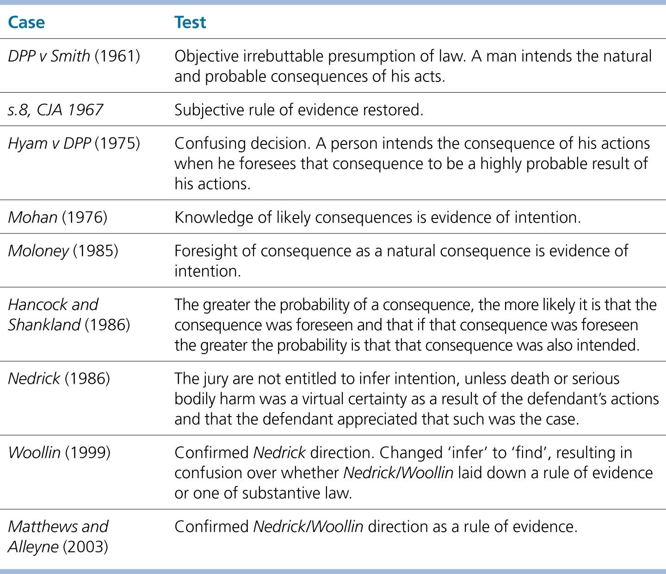
Table 3.2 Summary of cases on oblique intent

Slide 15
Nedrick [1986]
Important Court of Appeal decision on indirect/oblique intention
Defined oblique intention in the case of murder (death or GBH must have been a virtual certainty).
Jury must be sure that the defendant realised that death or very serious harm was virtually certain barring some unforeseen intervention to be able to infer that the defendant had oblique intention.
The effect is that “a result foreseen as virtually certain is an intended result”.
That it may be very probable was not enough, the outcome had to be a virtual certainty, and the defendant had to realise this fact.
The jury should be given a special direction whenever the question of indirect intention arises. This direction has been slightly altered by the case of R v Woollin [1999] 1 AC 82.

Slide 16

Woollin [1999]
Woollin Direction to the jury:
The jury should be directed that they are not entitled to find the necessary intention unless they feel sure that death or serious bodily harm had been a virtual certainty (barring some unforeseen intervention) as a result of D’s actions, and that the defendant appreciated that such was the case.’
The only change to the Nedrick direction is that the word
‘find’ has replaced the word ‘infer’.

Slide 17
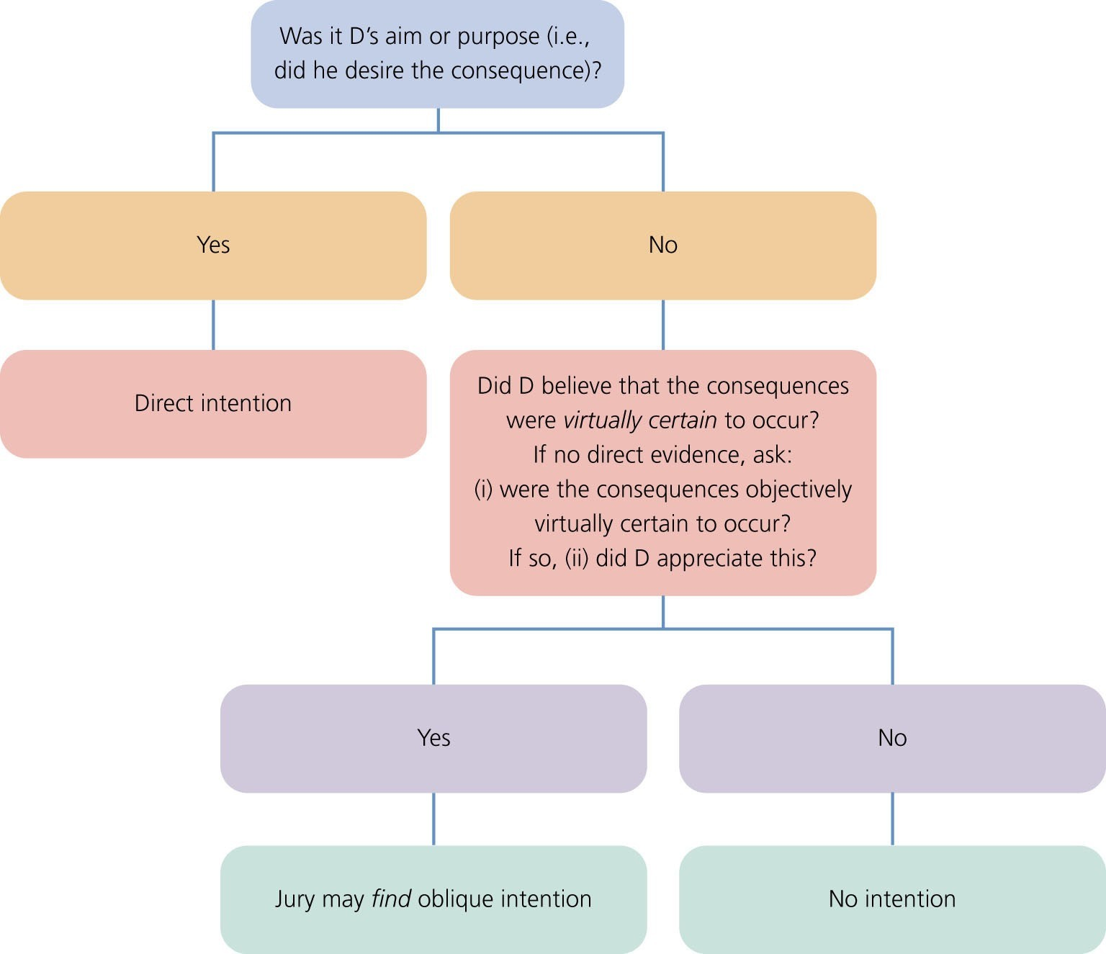
Figure 3.1 Did the defendant have the requisite intention (e.g., to kill or cause GBH)?

Slide 18
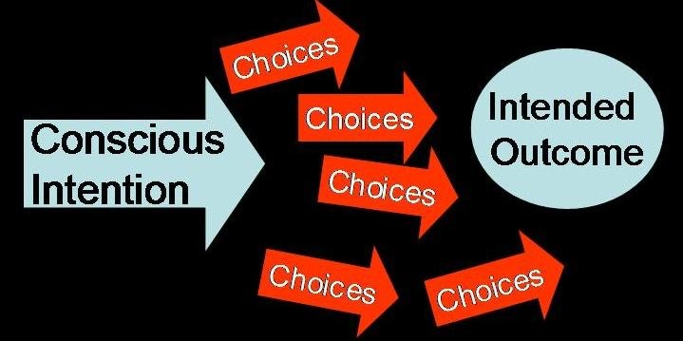
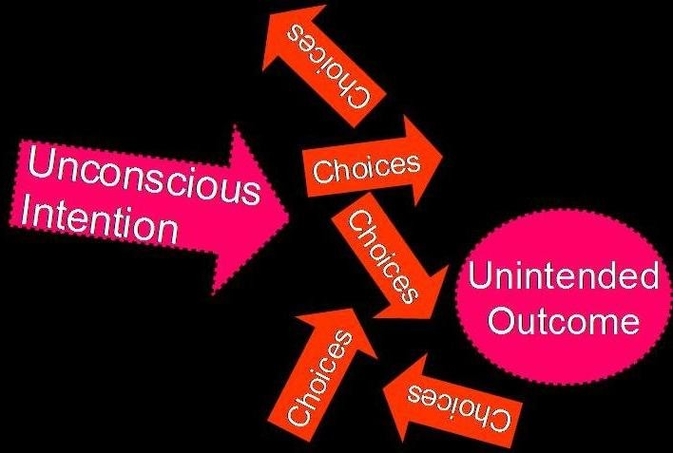
Direct Intent v Oblique Intent
Direct Intention = aim, purpose or desire
Indirect/Oblique Intention = intending one act which leads to another act and becomes the unavoidable result

Slide 19
Recklessness
Though the majority of criminal offences can be committed intentionally, some can also be committed recklessly (i.e. where the defendant does not intend to perform the actus reus of an offence, but does so recklessly).
For instance, criminal damage,
assault, battery, and offences that can be
grievous bodily harm are all
committed recklessly.
In general terms, when a person who does not intend to cause a harmful result, causes a harmful result by taking an
unjustifiable risk, then this person’s conduct may be considered “reckless”.

Slide 20
Recklessness explained through case law
Recklessness – taking an unjustifiable risk of a particular consequence occurring.
This is now a subjective test as set out in G and Another [2003] UKHL 50
But see previous attempts to define the test in Cunningham [1957] 2 QB 396 and Caldwell
[1982] AC 341

Slide 21
R v Cunningham [1957] 2 QB 396
This case involved the defendant tearing a gas meter off the wall of a cellar in an unoccupied house in order to steal money from it.
Gas then leaked from the meter, seeped through the cracks in the wall, and poisoned the defendant’s mother in law, who was sleeping next door.
The defendant was convicted of the offence of “maliciously administering a noxious thing so as to endanger life” under Section 23 of the Offences Against the Person Act 1861, after the trial judge directed the jury that “malicious” in this context simply meant “wicked”.
On appeal, the Court of Appeal quashed the earlier decision, and held that “malicious” in this context meant either “intention” or “recklessness”.
In other words, the defendant should only have been convicted of the offence if he had either intentionally or recklessly poisoned his mother in law. But what does “reckless” mean?

Slide 22
R v Cunningham [1957] 2 QB 396
The court held that a defendant will have acted “recklessly” if:
  they are aware of the existence of a risk; and
  having become aware of the existence of that risk, go ahead and unreasonably take that risk.
In other words, in order for a defendant to be found to have acted recklessly, they must be “aware” that what they are doing will create a risk of the actus reus of a criminal offence being performed, and then go on to unreasonably take that risk.
R v Cunningham [1957] 2 QB 396 decided the test should be a subjective one: a knowing disregard of an appreciated and unacceptable risk of causing the injurious result i.e. the defendants themselves must perceive the risk
However, the law has not always been as straightforward, and it is useful to consider how it has developed over time – see Caldwell [1982] and G and Another [2003].

Slide 23
R v Caldwell [1982] AC 341
EITHER:
The defendant was aware of the existence of an unreasonable risk
OR in the case of an obvious risk
The defendant failed to give any thought to the possibility of any such risk
But who decides what is an obvious risk?
Answer = the jury - Objective test as is based on what the ‘reasonable bystander’ would perceive
Potential unfairness for:
  Young people
Elliott v C [1983] 1 WLR 939
  People with mental illness
R v Stephenson [1979] QB 695 - Blurs the line between reckless
(knowingly) and negligent (inadvertently) taking of an unjustifiable risk

Slide 24
R v G and Another [2003] UKHL 5054
In this case the two child defendants were found guilty at first instance of causing criminal damage.
This decision at trial was reached by applying the decision in Caldwell (objective test)
However, on appeal to the House of Lords overruled the decision and substituted Cunningham recklessness as the correct test
Cunningham test (subjective test) = a knowing disregard of an appreciated and unacceptable risk of causing the injurious result i.e. the defendants themselves must perceive the risk
THEREFORE: to be found guilty of criminal damage, the defendant must both
  cause the injurious result, and
  have a culpable state of mind , which is EITHER:
    Intention, OR
    Recklessness (Cunningham Subjective Test)

Slide 25
Lord Bingham of Cornhill in R v G and
Another [2003]
“Can a defendant be properly convicted on the basis of being reckless as to whether property was destroyed or damaged if he gave no thought to the risk, but by reason of his age or personal characteristics, the risk would not have been obvious to him, even if he had thought about it?”
“In R v Caldwell the law took a wrong turn”
“It is neither moral nor just to convict a defendant, least of all a child, on the strength of what someone else would have apprehended if the defendant himself had had no such apprehension”.

Slide 26
Negligence?
“Negligence involves a failure by the defendant to comply with an objective standard set by the law […] Whereas intention and subjective recklessness require proof of D’s state of mind – foresight of the risk of the proscribed harm – negligence may be conclusively proved by simply showing that D’s conduct failed to measure up to an objective standard” D. Ormerod (2008) Smith and Hogan, Criminal Law, 12th Ed, p. 141.
Negligence is regarded by some as not really a type of mens rea because it does not require consideration of the state of mind of the defendant, which it is said that mens rea does.
Negligence imposes an objective standard on a defendant and can be satisfied by inadvertence to an obvious risk.
The defendant’s conduct is judged against the conduct of the hypothetical reasonable person.
This means that the characteristics of the defendant are not to be taken into account when assessing his fault.
It is irrelevant that a defendant was unable to understand or did not know of a risk.
Negligence is a much wider fault element than intention or recklessness.

Slide 27
Negligence?
A person is negligent when:
1.
They fail to foresee a risk that a reasonable person would have foreseen; or
They do foresee the risk, but either do not take steps to avoid the risk or
take inadequate steps, thereby falling below the standard to be expected of the reasonable person.
2.
At common law, negligence is rarely sufficient for criminal liability.
•
The offence of gross negligence manslaughter requires a much higher degree of fault than ordinary tortious negligence.
The concept of negligence is used much more readily in statutory offences, although most of these are regulatory in nature.
Examples:
o
Section 3 of the Road Traffic Act 1988 provides for the offence of driving without due care and attention. This offence requires the defendant to drive in a way which falls below the standard of driving to be expected from the reasonable person.
Section 5 of the Domestic Violence, Crime and Victims Act 2004 provides
for the offence of causing the death of or serious physical harm to a child or vulnerable adult.
o

Slide 28
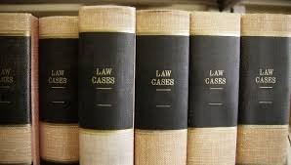
Negligence explained through case law
Negligence – failure to appreciate circumstances or consequences that a reasonable man would have considered
Is it the same as the civil standard of ‘want of care’?
NO. See Andrews v DPP (1937) AC 576 per Lord Atkin. See its application in R v Adomako [1995] 1 AC 171

Slide 29
ADOMAKO GROSS NEGLIGENCE
Death Involved Gross Negligence That Was ‘So Bad’ as to Amount to Criminal Liability
Duty of Care Owed to V
Breach of That Duty of Care by D
Breach Caused V’s Death

Slide 30
The Doctrine of Transferred Malice/Mens Rea
Applies where D aims to harm one person or property but misses and harms another.
If a defendant has the mens rea required in order to commit an offence against a specific person or property, but commits the actus reus against a different person or property, the mens rea in relation to the intended target will be transferred to the actual victim – see R v Latimer [1886] 17 QBD 359, R v Mitchell [1983] 76 Cr App R 293.
For instance:
  If A intends to punch B but, whilst attempting to punch B, A slips and punches C who is stood nearby, A’s mens rea for punching B will be transferred to C.
  A shoots B but misses and instead kills C – A can be convicted of C’s death if A had the intention to kill B
However:
  Where the offence intended and the offence performed are not the same, the doctrine will not apply (see Pembliton [1874] LR 2 CCR 119).
  The doctrine can only apply to a single transfer of intent and will not operate in respect of a double transfer (see AG’s Reference (No. 3 of 1994) [1998] AC 245).

Slide 31

Part 2 – Interactive Activities

Slide 32
MCQs
Which of the following is the most suitable description of indirect intent?
  Where D does not desire the consequences but they are virtually certain to occur and D appreciates this;
  Where D does not desire the consequences but they are highly probable to occur and D appreciates this;
  Where D does not desire the consequences but foresees them as possible to occur;
  D’s aim or purpose.

Slide 33
MCQs
2) Which of the following is currently a leading authority on indirect intent?
Hyam v DPP;
Moloney;
Hancock and Shankland;
Woollin.

Slide 34
MCQs
3) Carl plants a bomb in a public library in order to protest about redundancies. He alerts the library manager about the bomb 15 minutes before it explodes. Carl knows that there is a chance that somebody working in the basement might not be evacuated in time, but he thinks that this is unlikely. Which of the following terms best represents Carl’s mens rea in respect of harming any person?
Indirect intent;
Subjectively reckless;
Direct intent;
Objectively reckless.

Slide 35
MCQs
4) Which of the following is currently the leading authority on recklessness?
R v G and Another;
Caldwell;
Woollin;
Elliott v C.

Slide 36
MCQs
5) Which of the following statements is a FALSE representation of the mens rea of murder?
D’s aim or purpose is to kill;
Death is virtually certain to occur and D appreciates this;
GBH is highly probably to occur and D appreciates this;
D’s aim or purpose is to cause GBH.

Slide 37
MCQs
6) Which of the following statements about negligence is FALSE?
Negligence is failing to foresee a risk that a reasonable person would have foreseen;
Negligence is foreseeing a risk, but taking inadequate steps to avoid the risk, thus falling below the standard to be expected of a reasonable person;
Negligence is foreseeing a risk, but failing to take steps to avoid the risk, thus falling below the standard to be expected of a reasonable person;
Negligence is subjectively assessed.

Slide 38
MCQs
7) In which of the following authorities was the doctrine of transferred malice successfully relied upon?
Pembliton;
Latimer;
Attorney General’s Reference (No 3 of 1994);
Thabo Meli.

Slide 39
MCQs
8) Jack throws a stone towards a dense crowd of people intending to strike Ted but aware that he might strike another person. Unfortunately, the stone strikes Habib. Which of the following statements is not a valid reason for convicting Jack of battery in respect of Habib?
Because Jack failed to foresee a risk that a reasonable person would have foreseen;
Because the actus reus and mens rea coincide;
Due to the application of the doctrine of transferred malice;
Because Jack is reckless as to whether he inflicts force on Habib.

